Slide 1
Māori Women Keeping Safe in Unsafe Relationship
The Ripple Effect 2023: Journeys of Healing and Voices of Victims
5 December, Bethlehem Baptist Church, Tauranga, Bay of Plenty
Dr Denise Wilson, Professor Māori Health | Co-Director Taupua Waiora Māori Research Centre | Associate Dean Māori Advancement
Faculty of Health & Environmental Sciences, Auckland University of Technology

Slide 2
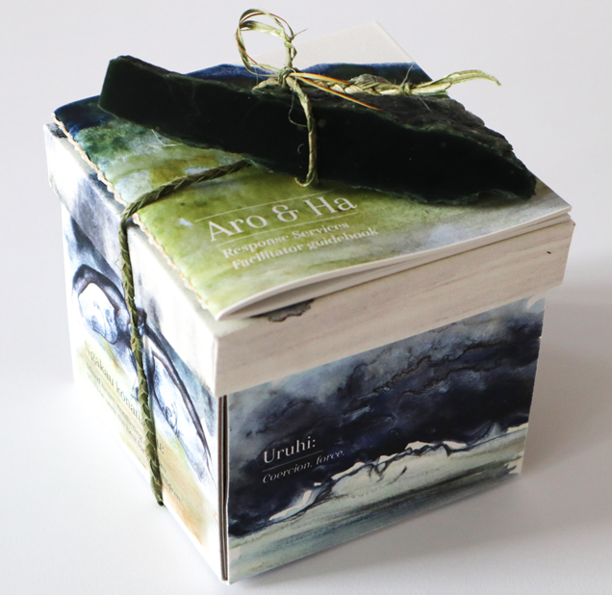
Outline
Explore the framing of family violence using the concepts of:
Coercive control
Entrapment
Wāhine Māori and safety planning:
Isolation, compliance and silence as safety strategies
Role of the family violence system in the entrapment of Māori in relationships with violent partners

Slide 3
How do Māori women keep safe in unsafe relationships?
Aims
Challenge the common perception that Māori women are passive 'victims' of domestic violence and
Explore new and culturally appropriate ways of thinking about how Māori women are active in protecting themselves and their children.

Slide 4
Demographic information
AGE
Range: 16-61 years
Mean age: 40.5 years
+
11
AGE
Mid-30s to mid-60s
All used alcohol and drugs
All currently violence-free
75%
Sole Māori Ethnicity
28
86%
Currently Violence-free
7+1
N=28
Approx. 1/3
Gang association
Not all grew up with violence
30%
Gang Association
83%
Contact with (Ex-) Partner
-

Slide 5
Wāhine: Experiences of violence
HISTORY OF VIOLENCE
10
(36%)
11
(39%)
Immediate
Friends
wh?nau
12
(43%)
16
(57%)
T?ne grew up
Wider wh?nau
with violence
DIMENSIONS OF VIOLENCE
9
(32%)
8
(29%)
13
(46%)
Multiple violent
W?hine use of
Tamariki also
relationships
violence
abused
21
(75%)
16
(57%)
Alcohol present
Drugs present
TYPES & EFFECTS OF VIOLENCE
26
(93%)
22
(79%)
?
Physical violence
28
Lasting impact of
(100%)
psychological
Sexual violence
violence
Traumatic brain
Psychological
injury (TBI)
violence

Slide 6
Wāhine: Protection order utility and involvement of other agencies
PROTECTION ORDERS
14 (50%)
Protection orders
7 (50%)
Utility of protection orders
INVOLVEMENT OF AGENCIES
11 (39%)
Child protection services
24 (86%)
Police
26 (82%)
Other agencies

Slide 7
Wāhine: Aroha and manaakitanga
Hope and see potential in their tāne – not always ‘bad’
Tāne have their own story
compassion and empathy
Tāne need to heal
They don’t try to fix/heal them
Need to stay strong
Deteriorating relationships
Alcohol, drug, and violence - increase
I love him, even though he’s a dick. You take the good, you weigh it up, get rid of the bad and work on the good. I applied that to my partner and I think back on it you know, no one pastoral cared us, no one cared. So, we kind of did it ourselves. What I loved about my ex-partner is there’s an internal core of him, one of his values of his heart is still relatively good and healthy.
Image source: https://www.endemicworld.com/aroha-ferns-art-print-by-glenn-jones.html

Slide 8
STRATEGIES FOR PROTECTING OTHERS
Using Self
Mediating
Being
Being
Smart
Prepared
•
Never leave
•
Talk him down
•
Knowing where
•
Using themselves
siblings, tamariki,
•
Give illusion
everyone is at all
as distractions
others alone
everything is okay
times
•
Intervening and
•
Bags packed &
•
Being a good
•
Creating a ‘stranger
getting in between
hidden
partner
danger’ plan so
the user of
•
Parking carefully
•
Keeping house
Police respond
violence and target
so can leave
clean and tidy
•
Not drinking around
•
Hiding knives at
•
Knowing where to
•
Keep concerns,
tamariki
night
hide their children
worries and
•
Use ‘safe’ phone
•
Pushing user of
•
Having activity
frustrations to self
•
Mantras like
–
kids,
violence away
packs planted
keys and car
•
Outrun partner
around home to
•
Run onto the street
occupy tamariki if
•
Disconnecting from
needed
social media
Notes:
Being Safe: A Range of Strategies
OCCUPYING TAMARIKI
“Like dinner time I’d quickly put them [tamariki] on the table and I’d put not just their dinner, it would be like lots of snacks around the table just so they can stay on the table. So that you know there was actually, there was a lot of weird things I was doing just to keep them from… like I would turn on the tap and put containers down on the ground. As much as they thought it was fun, but really it was to protect them from not getting hurt.”
COMPLIANCE FOR SAFETY
“I would do anything that he would ask even if I didn’t agree with it just to, keep it safe for myself and my children. And I would allow him to treat me like peasant and a slave just so I didn’t get a hiding from him.”

Slide 9
Navigating Being Safe & Unsafe
THE CONTEXT
Constant threats | Surveillance |
Control | Isolation | Bearing the burden |
Daily, episodic, unpredictable risk
BEING UNSAFE
VIOLENCE:
Partner +/- whānau
Partner’s coercive control
AGENCIES
Unhelpful people
↓ Trust ↑ Fear for safety & life
SOCIETAL
Stigma
Systemic & interpersonal racism
BEING SAFE
PROTECTION & SAFETY
Tamariki 1st
Others
STRATEGIES
(Adaptive & Maladaptive)
Knowing, monitoring & managing partner’s triggers
Children’s safety
Being prepared
Protecting others
Isolation, silence & compliance
Use of violence
Strength
Primal intelligence
Knowing safe people, places, spaces
The Nexus

Slide 10
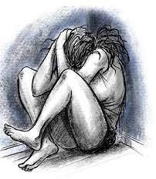
A life shaped by violence
Why didn’t I ask for help? I was unable to seek help. I was embarrassed, ashamed, confused and didn’t trust strangers, not helped by having black eyes and being under the influence of meth. The mere thought of going to organisations for help engendered a sense of dread and hatred – I knew I wouldn’t be welcome and the people in them were always quick to judge me. Besides, they have taken my kids away. The simple truth is, I didn’t feel vulnerable getting the bash or being scared. I felt totally vulnerable having to go to organisations and ask for help. I no longer had a choice if I wanted to be in my child’s life.
Source of image: NZ Herald

Slide 11
Multiple forms of oppression
State Violence
Colonisation
Māori Ethnicity
Trauma:
Historical|Contemporary
Welfare
Dependency
Education
Whānau Māori
Social & Health
Inequities
Intergenerational
Incarceration
Gender
Digital Divide
Employment:
Under|Unpaid|No
Racism|Discrimination

Slide 12
Understanding Māori women’s own life story using intersectionality
Context
Life-world
Help-seeking but… is it helpful?
Responses to social responses
Social setting
Biases & assumptions operating
Unintended consequences
Understand Māori women’s self-medication for violence & trauma with alcohol and drugs
RESPONSE-BASED CONTEXTUAL ANALYSIS
Getting the story right!
Social Interaction
Dignity
Accurate description
Social justice
Social network
Institutional responses
Adversity
Offending actions
Understand Māori women’s being forced to commit, and/or take responsibility for partner’s, crime
Understand Māori women’s social and institutional support and the responses they receive
Victim Responses
Acts of resistance
Understand Māori women’s use of violence
Richardson & Wade (2010)

Slide 13
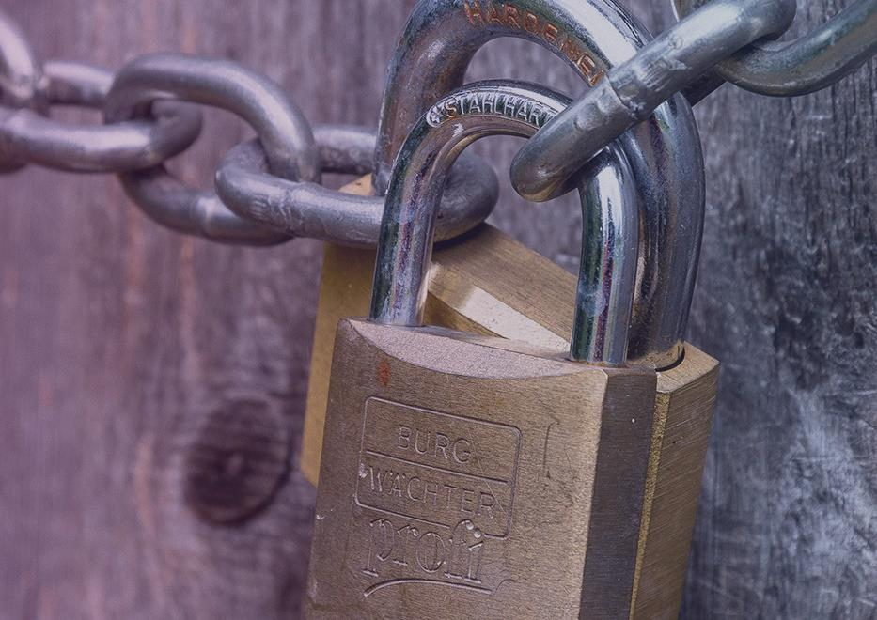
Coercive Control
… perpetrators use various means to hurt, humiliate, intimidate, exploit, isolate and dominate their victims. … unlike other capture crimes [like kidnapping], coercive control is personalized, extends through social space, as well as over time, and is gendered in that it relies for its impact on women’s vulnerability as women due to sexual inequality. … Men deploy coercive control to secure privileges that involve the use of time, control over material resources, access to sex, and personal service. Like assaults, coercive control undermines a victim’s physical and psychological integrity (Stark, 2007, p.5).

Slide 14
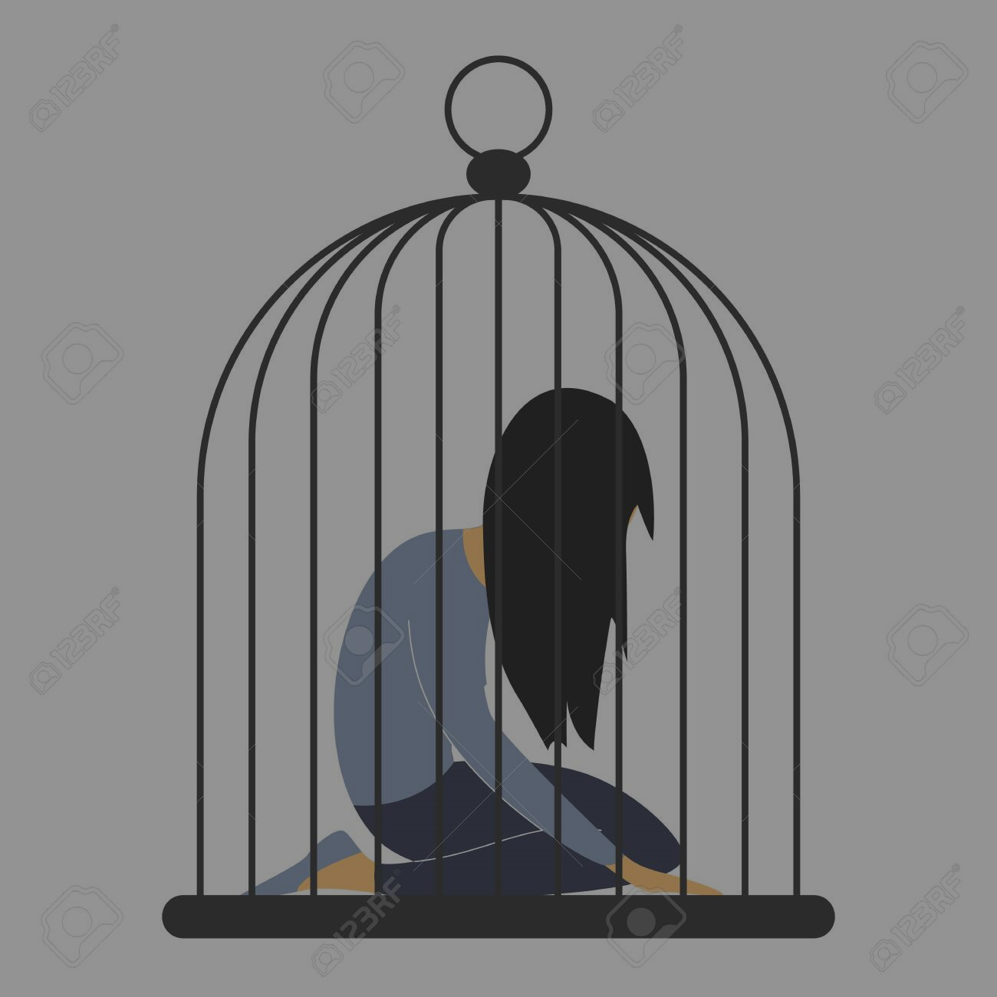
Strategy of subordination
Image source: https://www.americanoutdoor.guide/survival-skills/knuckle-sandwich-how-to-throw-a-proper-punch/
Reduces a person’s:
Autonomy
Agency
Basic liberty or freedom
Equality
Coercive control occurs often without the use of physical violence
Image source: https://sosviolenceconjugale.ca/uploads/tools/articles/sos_img_filtre_1575x660_54-1575x660.jpg

Slide 15
Coercive Control – Occurs in Many Ways
Terror and fear
Subjugation
↓ Autonomy
↓ Agency
↓ Freedom
Extensive and intensive but seemingly invisible to those on the outside
Tactics permeate everyday life
Similar to hostage-taking or kidnapping BUT [degrees of] ‘freedom’
“Layering Effect” (Adams, 2012)
Cumulative
Multiple, repeated episodes – unpredictable
COERCIVE CONTROL
Coercion
Manipulation
Isolation
Threats
Restrictions
Surveillance
(stalking)
(Stark, 2007)

Slide 16
Indicators of Coercive Control
MANIPULATION
ISOLATION
THREATS
Jealous behaivours
Play victim off against others
Sabotage
Justifying actions
Psychological abuse – verbal accusations – being told they are inadequate
Family and friends
Support
Help
Employment
Victim
Children
Family and friends
Pets
Co-workers
RESTRICTIONS
SURVEILLANCE
COERCION
Financial
Movements
Who can see
Where to go and for how long
Opinions and thoughts
Monitoring
Activities
Who see and interact with
Cellphone, computer activity, drones
Cyberstalking
Microregulation
Abuse or threats
Children | Women themselves
Pets | Family or friends
Presence and/or use of weapons
Forcing to do things normally would not do
Suicidal ideation

Slide 17
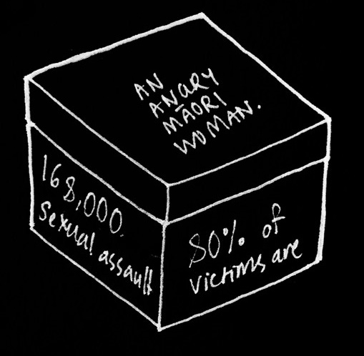
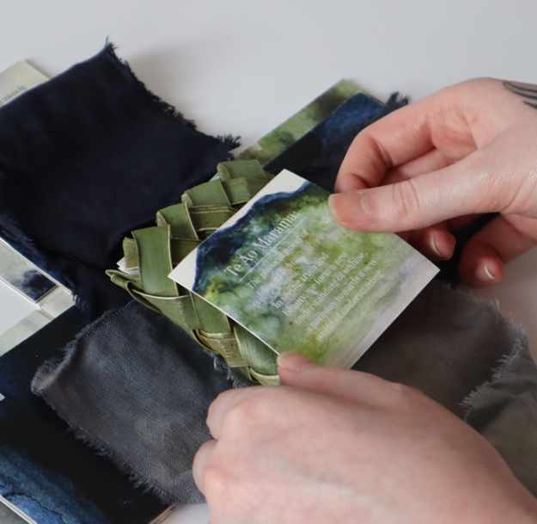
Communicating new understandings: Entrapment - coercive control is just one dimension of wāhine Māori women’s entrapment in a violent relationship

Slide 18
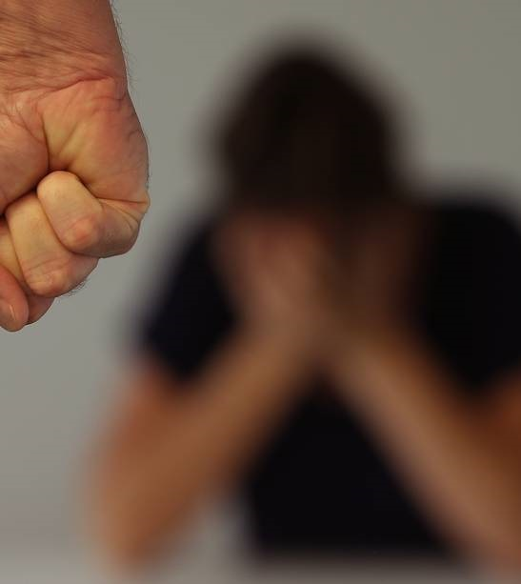
Social Entrapment
Social entrapment has 3 dimensions:
Social isolation, fear, and coercion created by the predominant aggressor’s coercive and controlling behaviour creates in the victim’s life
Indifference of powerful institutions to victim’s suffering
Exacerbation of coercive control by structural inequities associated with gender, class, race, and disability
(Tolmie, et al., 2019)
Recognition that dimension 3 includes the role of colonisation on structural inequities and adds historical and intergenerational layers for Indigenous women
(Tolmie et al., 2022)
Image source: NZ Herald

Slide 19
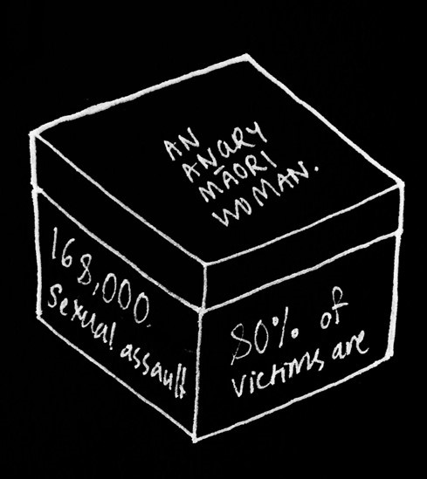
Systemic Entrapment
The role of they system in entrapping Māori women in violent relationships:
Fear their children will be removed
A fear based in reality
Fear they will be treated judgmentally, disrespectfully and in racist ways
Accused of being mad, bad and angry OR on the offensive expecting to be treated badly?
Encountering unhelpful people
Denied entitlements
Fragmented services that do not meet their needs
Refuge | Police | Income support | Housing | Health
Profound lack of trust that others will keep them safe

Slide 20
POLICE
STATE VIOLENCE
Neglect
63%
Failure to protect 54.1%
Abuse | Abuse of power 71.9%
Racism 83.5%
Police Violence 52.0%
Breaches of Te Tiriti o Waitangi 82.8%
Disengaged from services
Adhered to rules & laws
Navigated system through personal research and education
Advocacy
Self-advocacy
Healing & cultural practices and connections
Leadership
HEALTH
EDUCATION
IMPACT OF STATE & SYSTEM VIOLENCE IS SIGNIFICANT
WORK & INCOME
JUSTICE
(Simmonds, 2022)

Slide 21
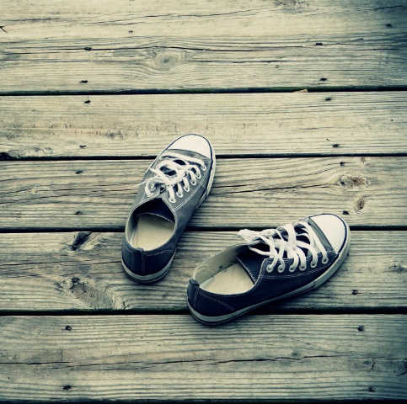
“Put Yourself in Our Shoes”: Wāhine Māori, partner violence, the media, and help-seeking (Karina Cootes, 2022 - MPhil)
Racial profiling
Effects of constant negative portrayal
Whakamā – profound shame
Already whakamā
Sets Māori women as bad parents and partners
Impacts help-seeking
Getting the story right

Slide 22
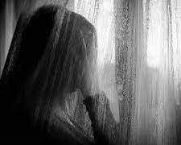
Coercive Violence
Coercive violence is a form of intimate partner violence in which the abuser intentionally engages in acts that expose his [sic] partner to state surveillance and violence at the behest of institutions or the state, including the child welfare system and the criminal legal system (Monterrosa & Hattery, 2022, p.1).
Violence perpetrated by institutions makes it difficult to obtain:
Justice
Protection needed
Secure resources needed for wāhine and their tamariki to live safely.

Slide 23
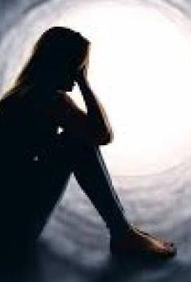
Entrapped by the system
I have a protection order for the tamariki’s safety – he’s not allowed to be around, but by some means, he always manages to. He took the phone the social worker gave me. He was released on monitoring at the relatives down the road, so he started sneaking into our house. I was happy when he was in jail, I didn’t have to worry.
Now, I only have half my freedom because he is still here. He physically and sexually abuses his tamariki’s mother in front of them!
No one in the agencies will help keep him away from us – they say I agreed for him to live down the road. I had no choice to agree because I knew from the look on his face and how he held his body that if I didn’t agree, we would suffer even more.

Slide 24
Beaten down by the system
She rolled up to my house one day, unannounced with an affidavit or summons or something for court for [unborn baby]. She rolls up and says, “Oh these are for you Pounamu, see you in court.” I thought, “What the hell? Aren’t you meant to like ring that you’re coming or something, don’t just turn up on my doorstep?” Anyway, I open-up the thing that she just left me. Honestly, I was like down like a dog. I was like kicked in the guts, kicked in the heart, kicked in the head with the psychological impact that this little shit had had on me in what she’d come up in her affidavit. I was, I was seriously impaired for about two days down and of all these years you know even the things that that [ex-partner]’s done to me, never have I actually been psychologically, emotionally and physically impaired as I had been from her.
Source of image: www.herald.co.nz

Slide 25
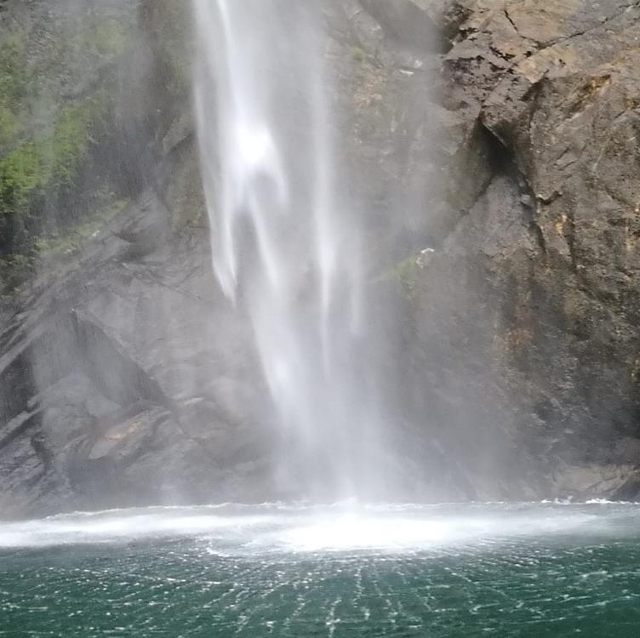
“Helping” and its Ripple Effect
The problem with many ‘helping’ agencies is that wāhine and their tamariki needing help
often don’t find them helpful and
They fear their children will be taken.
Reflect on our practice and consider how entrapment needs to be considered.
Think about key factors that need to be considered re safety planning
Barriers to helping

Slide 26
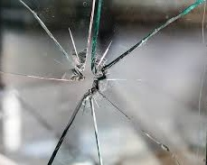
Ensuring safety
Relationships are crucial for gaining trust
Ask every encounter (when it is safe) you have with women what help they need
Remember what’s on top for women can change from day to day
What is critical to know?
Unintended consequences
Being proactive

Slide 27
Hearts and minds please!
Aria finally decided to leave her violent partner – it was July, wet and cold. She had 4 children – 2 older children, 2 under 3 years of age.
She had no money, no home to go to, no car, and only the clothes they were standing in.
Her whānau took them in BUT they were in a state house and were not supposed to have other people living with them. This was a source of concern for the whānau because it was a house for a person in a wheelchair.
It took weeks for Aria to get a benefit, and then another 6 weeks for her state house appointment. When she attended the appointment, she was told it was her choice to leave.
Source of image: https://nationaltoday.com/wp-content/uploads/2022/05/Mount-Everest-1200x834.jpg

