Slide 1
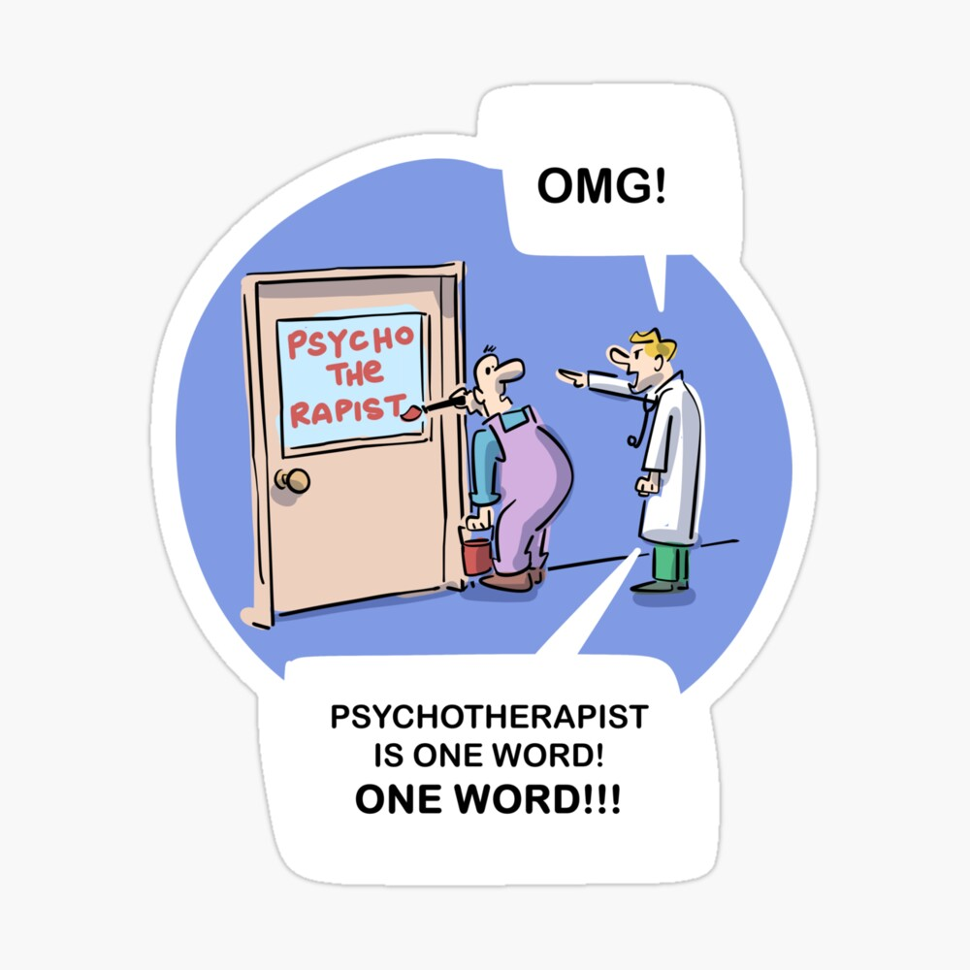
Mind your language
Intersectionality between
violence and language
in context

Slide 2
A critical analysis of language
The problem of language is inextricably linked to the problem of violence
A critical analysis of language is not merely a semantic exercise or ‘perspectives’ view
There are real life implications for how people are regarded and how language is used puts them there
Four discursive operations of language
Language of effects and impacts vs responses and resistance

Slide 3
… minding your language…
“Telling a professional that the language they use is wrong is risky business.
It’s a bit like telling a grandparent that their latest mokopuna is ugly.”
(Coates, 1995)
And although all babies are beautiful…

Slide 4
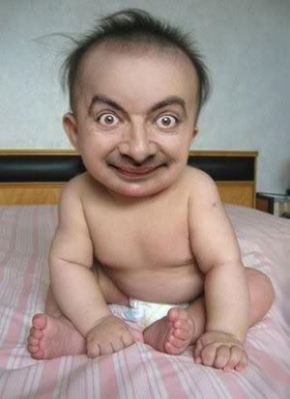
not all babies are beautiful equally!

Slide 5
(Example 1) An account of sexualised violence
He followed her down the footpath. He sped up to catch her. He grabbed her by the shoulders and threw her to the ground. He overpowered her and dragged her into the bushes. He held a rock over her head and threatened to kill her if she screamed. He called her degrading names. He kissed her on the mouth. He tried to undo her belt. He grabbed at her pant legs to pull them off. He overpowered her and vaginally raped her.

Slide 6
Four Operations of Language (Coates & Wade, 2004)
To Benefit Perpetrators & the Status Quo
Conceals Violence
Blames, Pathologizes Victim
Obscures Perpetrator Responsibility
Conceals Resistance

Slide 7

What is resistance?
The Scope of Resistance – Not a Definition
“Any mental or behavioral act through which a person attempts to expose, withstand, repel, stop, prevent, abstain from, strive against, impede, refuse to comply with, or oppose any form of violence or oppression (including any type of disrespect), or the conditions that make such acts possible, may be understood as a form of resistance” (Wade, 1997).
Wade, A. (1997). Small acts of living: Everyday resistance to violence and other forms of Oppression, (p. 25). Journal of Contemporary Family Therapy, 19.

Slide 8
Second account of sexualized assault
(Example 2) An account of sexualised violence
He followed her down the footpath. She sped up. He sped up to catch her. She moved to the side. He grabbed her by the shoulders and threw her to the ground. She rolled on the ground to get away and grabbed the roots of a tree so he couldn’t drag her into the bushes. He overpowered her and dragged her into the bushes. She started to scream. He held a rock over her head and threatened to kill her if she screamed. She stopped screaming. He called her degrading names. She said, “You don’t want to do this. You don’t want to hurt me.” He forced his mouth onto her face. She averted her face. He tried to undo her belt. She stuck out her stomach so that he could not undo her belt. He grabbed at her pant legs to pull them off. She crossed her ankles so that he could not pull off her pants. He overpowered her and vaginally raped her. She went to limp to avoid further injury and went elsewhere in her mind.

Slide 9
Reversing the Four Discursive Operations of Language
The Language of Resistance: Truth telling
Reveal the Violence & Oppression
Contest
The Blaming of
Victims
Clarify
Responsibility
Clarify Resistance
Notes:
The point here is that we refer to violence as trauma… this hiding people’s truth, people’s histories and refusing to acknowledge that the harm was done by someone… a perpetrator… If someone is not held accountable, it is more likely that the victim will suffer through self-blame

Slide 10
False Descriptions and Social Responses
Negative social responses are built on false and prejudicial descriptions.
Research shows that violent crimes, victims, offenders are often misrepresented in criminal justice, media, mental health, and so on.
Although victims invariably respond and resist, they are often portrayed as passive or only as affected or impacted.
Although violence is deliberate, offenders are often portrayed as out of control, helpless victims of their biology or emotions.
Although violence is unilateral, it is often portrayed as mutual.

Slide 11
On 5 November 1881, about 1600 volunteers and Constabulary Field Force troops marched on Parihaka. Several thousand Māori sat quietly on the marae as singing children greeted the force led by Native Minister John Bryce.
A Whanganui farmer had fought in the campaign against Tītokowaru and viewed Parihaka as a ‘headquarters of fanaticism and disaffection’. Bryce ordered the arrest of Parihaka’s leaders, the destruction of much of the village and the dispersal of most of its inhabitants. Many women were raped by troops, with some bearing children as a result.
Pressmen, officially banned from the scene by Bryce, were ambivalent about the government’s actions, but most colonists approved of them. The government managed to delay for several years the publication in New Zealand of the official documents relating to these events.
(“Invasion of pacifist settlement Parihaka”; nzhistory.govt.nz, 2022)

Slide 12
Reversing the Four Discursive Operations of Language
The Language of Resistance: Truth telling
Reveal the Violence & Oppression
Contest
The Blaming of
Victims
Clarify
Responsibility
Clarify Resistance

Slide 13
On 5 November 1881, about 1600 volunteers and Constabulary Field Force troops marched on Parihaka. They were asked to leave their weapons outside the pā. Several thousand Māori refused to use acts of violence and sat quietly on the marae as singing children greeted the force led by Native Minister John Bryce. This was a strategic effort to restore peace and uphold the mana of the tamariki who held an important role in tribal resistance.
A Whanganui farmer had fought in the campaign against Tītokowaru and viewed Parihaka as a ‘headquarters of fanaticism and disaffection’. Bryce ordered the arrest of Parihaka’s leaders. The leaders asked the soldiers not to hurt their wāhine and tamariki, and not to destroy their remaining food crops.
The soldiers destroyed much of the village and saw to the dispersal of most of its inhabitants. The Māori men still refused to use violence and willingly surrendered peacefully to protect their wāhine and tamariki from further violence. Many women were raped by troops, with some bearing children as a result. Pressmen, officially banned from the scene by Bryce, were ambivalent about the government’s actions, but most colonists approved of them. Māori appealed for the release of Tohu and Te Whiti. The government introduced the “Māori Prisoner’s Act 1881” which meant Māori could be imprisoned without trial. The government managed to delay for several years the publication in New Zealand of the official documents relating to these events.

Slide 14
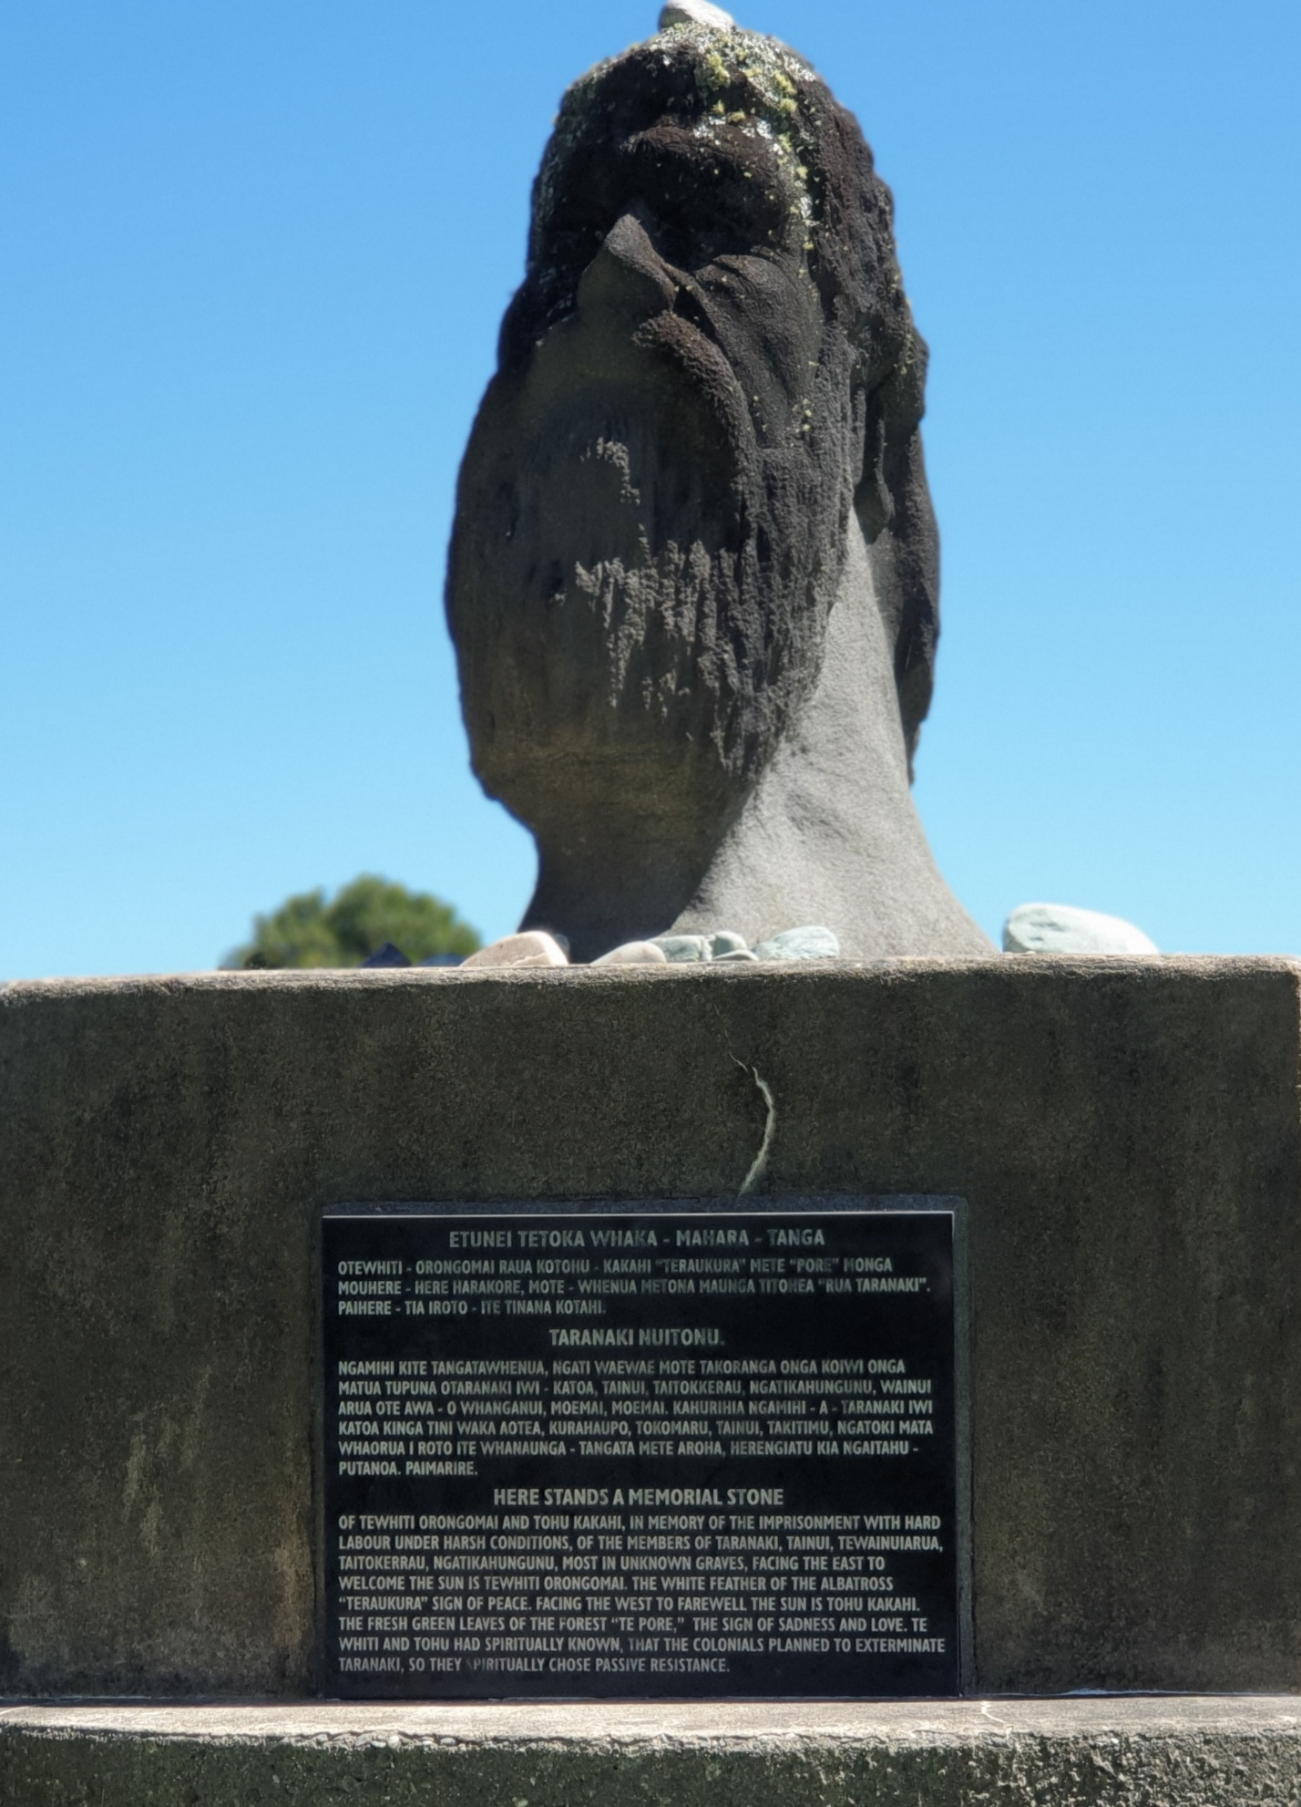
“Here stands a memorial stone of Tewhiti Orongomai and Tohu Kakahi, in memory of the imprisonment with hard labour under harsh conditions, of the members of Taranaki, Tainui, Teawanuiarua, Taitokerau, Ngāti Kahungunu, most in unknown graves, facing the east to welcome the sun is Tewhiti Orongomai. The white feather of the albatross “Teraukura” sign of peace. Facing the west to farewell the sun is Tohu Kakahi. The fresh green leaves of the forest “Te Pore”, the sign of sadness and love. Tewhiti and Tohu had spiritually known anticipated that the colonials planned to exterminate Taranaki, so they spiritually chose passive resistance strategically used non-violent active resistance to avoid further harm to their peoples and lands.”
Hokitika 2023

Slide 15

How we use language when we talk about violence is important...
Clinical language and legalese often nouns verbs, juxtapositions, superfluous obfuscation and oxymorons
... irony intended!

Slide 16
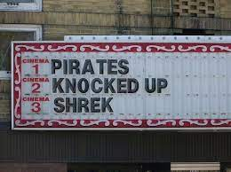
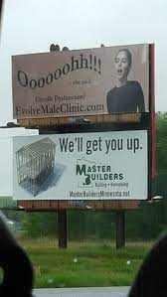
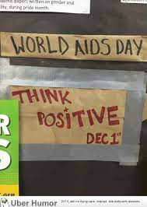
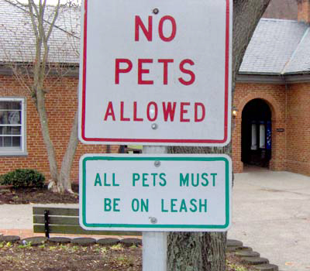

Slide 17


Example of superfluous obfuscation:
To operate the device firstly ensure you have interfaced the primary faculty with the cardinal conductor
The device is successfully interfacing it’s primary faculty with the cardinal conductor

Slide 18

Example of oxymoron:
The glass is
half full ....
… or fully empty

Slide 19
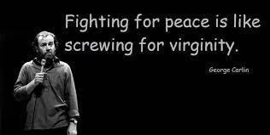

Slide 20
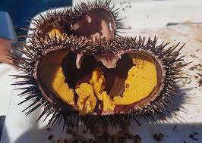
Delicious kina
(perhaps a juxtaposition and an oxymoron)

Slide 21
Where consent ends, violence begins
Consent is: a mutual dance of nuanced moment to-moment permission given fully by each person (of legal age)...
.... a handshake?
.... a kiss?
.... a boxing match?
.... having sex? (and stopping part way through)
Consent to sex can not be given by someone who is medicated, intoxicated, asleep or underage (16)
Silence ie: no response, means No

Slide 22
Shifting Language From Clear to Obscure
Active: John hit Jane
Simple passive: Jane was hit by John
Agentless passive: Jane was hit
Nominalization: An assault took place
Mutualizing: They had an abusive relationship
Conflict resolution
Neutralising: They had a disagreement
Anthropomorphizing: Advantage was taken of a situation that presented itself. The argument travelled down the hallway and into the bedroom

Slide 23
“minding your language” restores mana, dignity and hope
Sex and violence do NOT go together! ‘Sexual’ implies consent
.... Sex with a minor or child rape?
.... Sex tourism or human trafficking?
.... Feeling someone up or sexualised assault?
.... Unwanted intercourse or rape?
.... Sexual abuse or sexualised abuse / violence?
.... Trauma or violence?

Slide 24
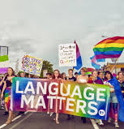
Settlement or land theft?
A personality clash or unilateral harassment?
NZ Wars or colonial invasion?
Our shared history or genocide?
Inter-generational trauma or inter-generational violence?
Truth and reconciliation?
NOTE: A virgin is someone who has not had sex, therefore does not apply to someone who has been raped

Slide 25
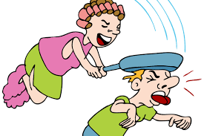
A Canadian genius once said…
If you hit someone with a frying pan… you don’t call it cooking

Slide 26
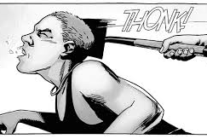
If you hit someone with a shovel you don’t call it gardening

Slide 27
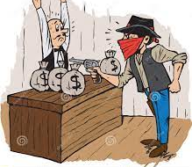
If you rob a bank…
you don’t call it a credit control

Slide 28
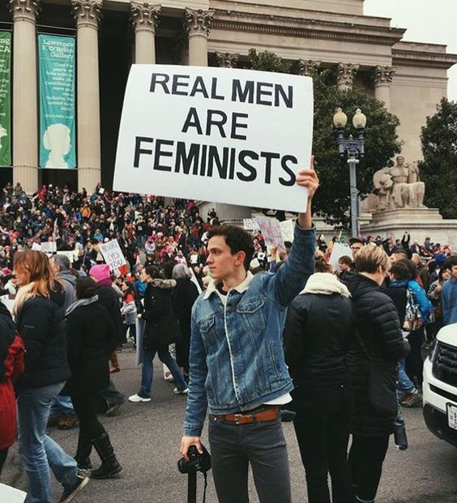
So… you don’t attack someone with your genitals, on theirs, and call it sex
Yet sadly these constructions are commonplace in public and professional discourse (especially in clinical and legal settings)

Slide 29

For victims of violence, naming violence accurately, helps them recover and feel there is justice and support.

Slide 30
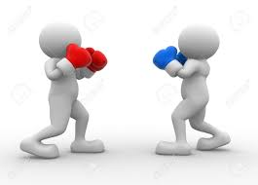
The Language of
Impacts & Affects vs the Language of Resistance & Responses

Slide 31

Example:
What happens when....
John drops a hot cup of coffee on the floor…
impact?
effect?
resistance?
response?
John throws a cup at the window…
John gets drunk and throw a cup at a person…
So let’s ban cups and send John to AoD counselling or anger suppression course?
Get more ambulances at the bottom of the cliff?
Are we fixing the cause, the affect or the response?

Slide 32

Does this make sense..?
Trauma causes depression, despair.
Depression, despair is an affect or impact of sexualised violence.

Slide 33
Impact, Affect or Response?
“When I was 5, I got beaten up by the teacher and separated from my tuakana for speaking te reo Māori at school… so I didn’t want you kids to learn” (Morehu)
“When he gets home from work I make sure the kids are in bed skull a couple of vodkas to get my game face on” (Ngahuia)
“My counsellor is a dickhead but (the court says) I have to go... I hate it... so I always show up late for my appointments” (Julie)

Slide 34

Rain causes umbrellas.
Umbrellas are affects, impacts, consequences of rain…?

Slide 35
Negative bias in the language of the effects and impacts
A negative cause such as spouse assault or childhood sexualised violence can only lead to negative effects...
We cannot say “childhood sexualised violence causes alert and effective parenting”
Or “alert and affective parenting is one of the leading affects and impacts of childhood sexualised violence”
But we can say “many people respond to childhood sexualised abuse by becoming alert and effective parents”

Slide 36
Some Outcomes of Affects & Impacts Language
Leads to Objectification
Negative Bias
Invalidates Resistance
Conceals Violence
De-contextualises
Positions persons as the Passive Victim
Language of Effects & Impacts
Invalidates or Invisiblises Responses
Conceals Resistance
Responses become internalised objects and Pathology
Obscures offender responsibility
Pathways to victim Blame
Expert knowledge Privilege & Power
Colonial discourse the passive native

Slide 37
Pathways to Victim Blaming
Violence
Language of Affects & Impacts
Person as ‘Affected Object’ (Passive)
Social Responses
What’s valued as ‘Resistance’ e.g. fighting back, leaving the relationship, failing to protect.. etc
Mutualising
Calling it: Sex, a violent relationship, a dispute, a personality difference etc
Victim Blame

Slide 38
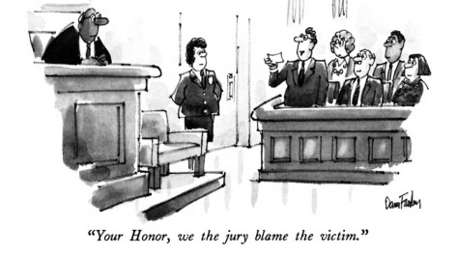
Examples of victim blaming...
If you weren’t so.....
then I wouldn’t be so....
Or
If you didn’t.....
then I wouldn’t have to ......

Slide 39
Wealthophelic person obtains illegal credit control
Tauranga police arrested Dane Haskell yesterday for allegedly obtaining credit to the amount of $500,000.00 from ASB Bank. The bank clerk, who agreed to the transaction when a gun was pointed at her face, was traumatised. “I’m just happy the incident is over”, said Rachel Rangikotua, who has participated in three similar transactions in recent years. “I don’t know why greedy customers choose me, I must just like being robbed”, she said.
The bank manager, Mr. R.E. Tentive, stressed that Ms Rangikotua would receive “psychiatric help to address her trauma and ensure she no longer attract greedy customers.” Mr Haskell was released on the condition that he have no contact with bank clerks and attend counselling for “wealthophelia” - a congenital condition more common in first degree biological relatives living near fabulous Tauranga beaches, characterized by the compulsive pursuit of illegally obtained financial independence.

Slide 40

So please mind your language…
Noun less…
Verb more…
A person is violated not traumatized…
Māori suffer from inter-generational violence, not inter-generational trauma…
And people need to attribute their suffering to deliberate acts of violence to restore their mana and heal

