Slide 2
WAIRUA ORA
HEALING TRAUMA thru FORGIVENESS
www.wairuaora.com

Slide 3
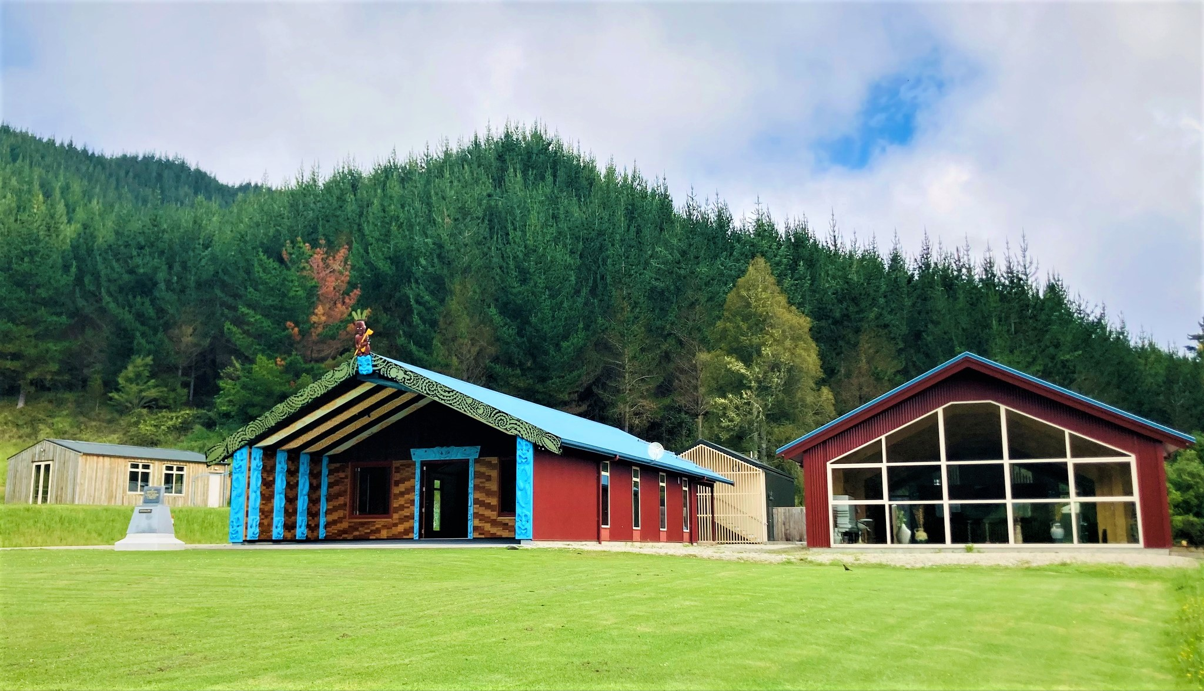

Slide 4
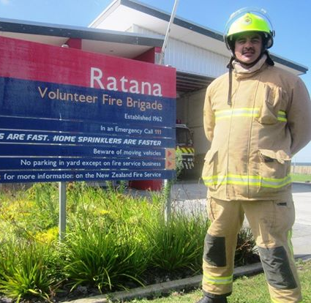
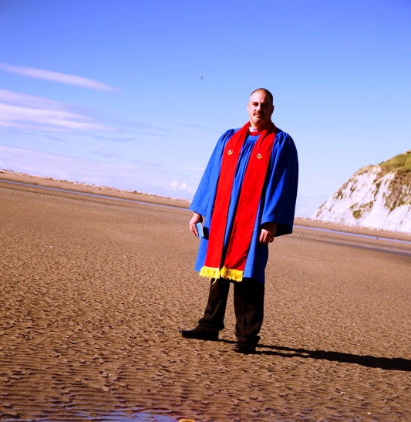
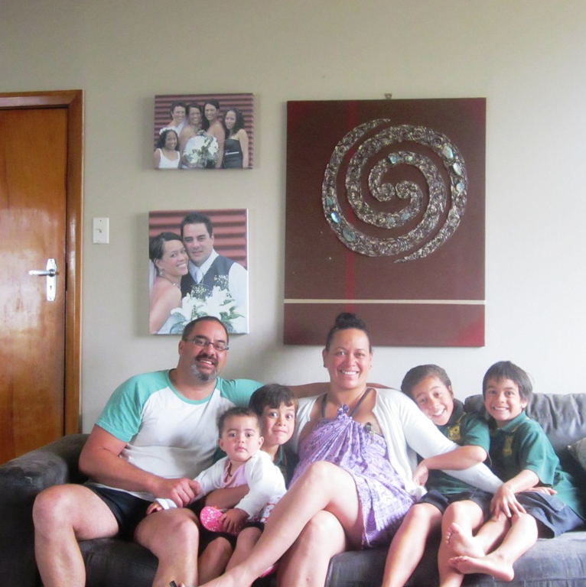
25 YEARS OF SERVING WHĀNAU, IWI & COMMUNITY

Slide 5
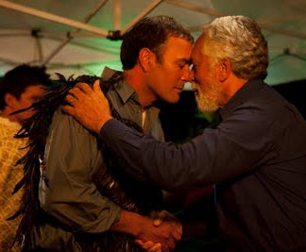
“He Was Lost… But Now He is Found”

Slide 6
SOOOO…. LET ME START BY ASKING YOU ALL THREE QUESTIONS??

Slide 7
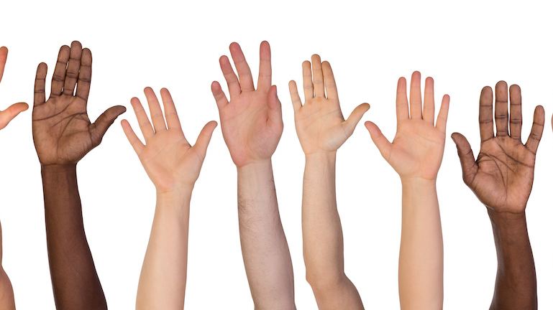
1) HANDS UP WHO HAS BEEN HURT BY SOMEONE?

Slide 8
2) HANDS UP WHO HAS HURT OTHERS?

Slide 9
3) HANDS UP WHO FEELS THEY ARE STILL CARRYING ANGER AND RESENTMENT?

Slide 11
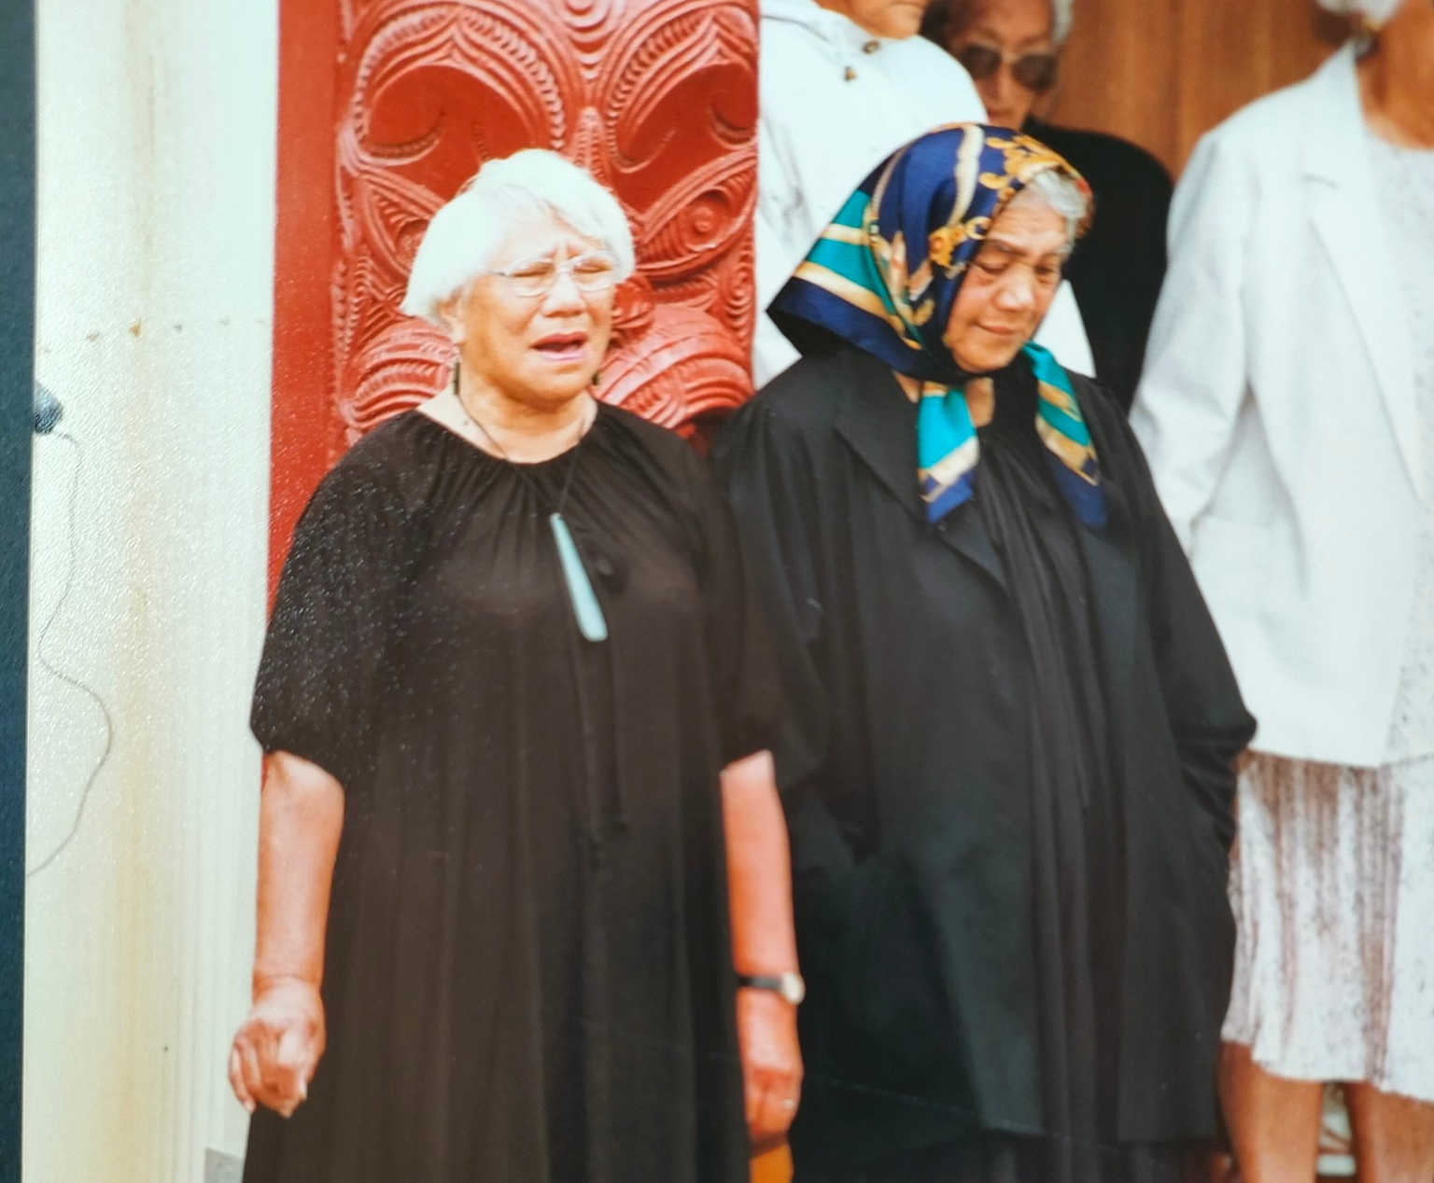
“Ko te Murunga Hara, te Rongoa mō te tino taumahatanga, te mamaetanga, hei oranga wairua, hei oranga tinana, hei oranga mōhou me tō whānau”
“Ko te murunga hara, he rongoa mō te taumahatanga me te mamaetanga, hei oranga wairua, hei oranga tinana, hei oranga mōhou me tō whānau”
– Rohi Ehu Thompson
“Forgiveness is the medicine for deep hurts, it will refresh your spirit, it will replenish your body but most importantly it is life giving for you and your whanau”

Slide 13
TWO QUESTIONS I GET ASKED BY MY CLIENTS ALOT…

Slide 14
1. How can I forgive others who have hurt or wronged me?

Slide 15
2. How can I forgive myself for hurting others, especially my whānau, my wife, my kids?

Slide 16
WAIRUA ORA
HEALING TRAUMA THRU FORGIVENESS

Slide 17
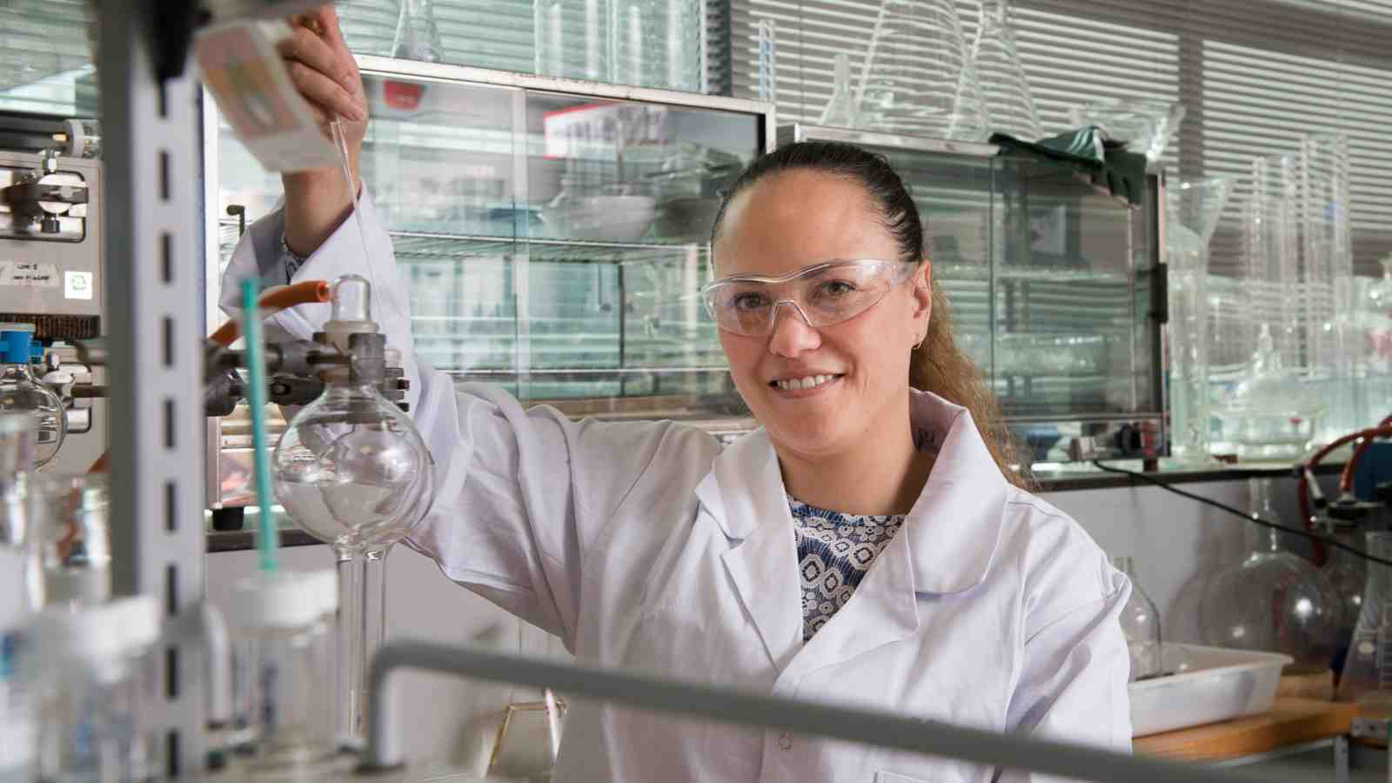
THE SCIENCE OF FORGIVENESS

Slide 18
BENEFITS of FORGIVENESS
Less Anger, Less Anxiety and Less Stress.
Fewer Symptoms of Depression.
Higher Self Esteem and Better Decision Making.
Healthier Relationships & Improved Feelings of Wellbeing

Slide 19
WHY IS FORGIVENESS IMPORTANT? 1. Because forgiveness helps those who are living with trauma and are wanting to heal hurts and get rid of negative past memories and thoughts. 2. Because forgiveness helps those who wish to improve their lives, reduce anxiety, be free of grudges, resentment and hatred. 3. Because forgiveness helps those who want to feel more aroha and embrace life in its fullest.

Slide 20
SELF - FORGIVENESS

Slide 21
HEROES of FORGIVENESS

Slide 22
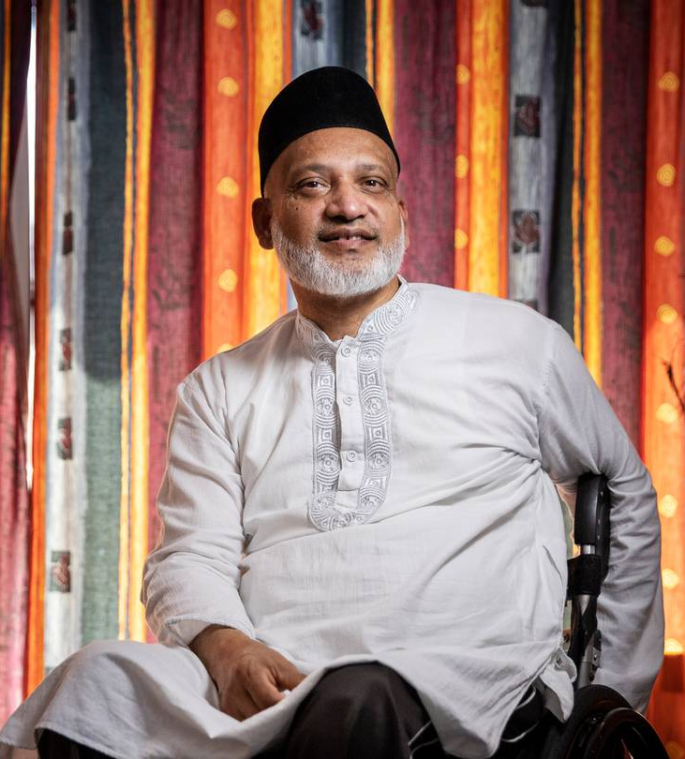
Farid Ahmed
2019 Christchurch Terrorist Attack Survivor
“I had to surrender myself to my fate, to surrender myself to God and that was for peace of mind.
I decided that no matter what happens, I have to choose forgiveness, I have to choose love in my heart. And that’s the only way I can feel peace thru forgiveness. The second thing I decided was, I would not be angry. Because if anger kicks in, I would lose that peace in my heart.”
- Farid Ahmed.

Slide 23
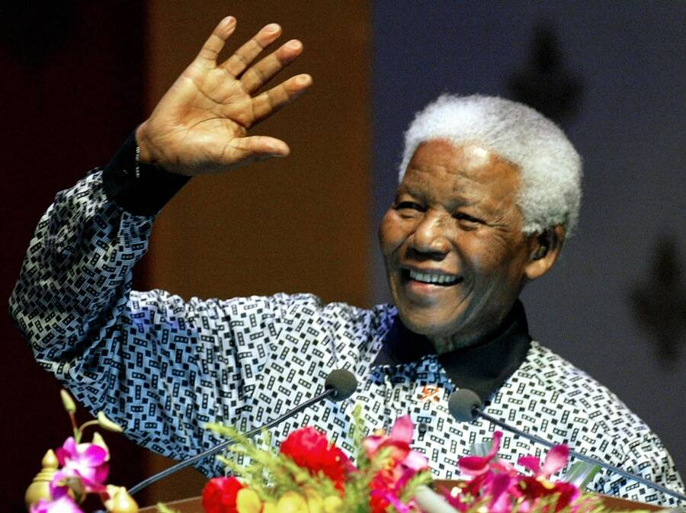
Nelson Mandela
(1918 – 2013)
“As I walked out of my cell door toward the gate that would lead to my freedom, I knew that if I didn’t forgive and leave my bitterness and hatred behind I would still be in Prison.”
- Nelson Mandela.

Slide 24
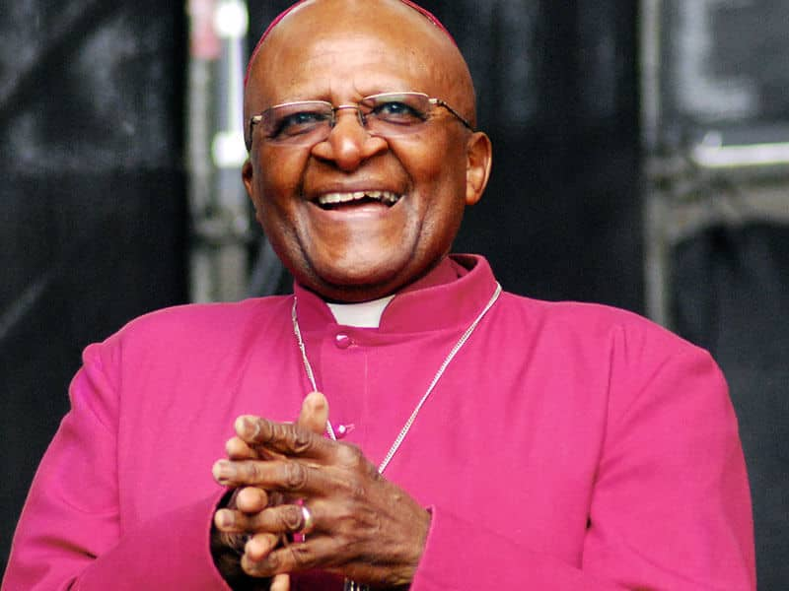
Desmond Tutu
(1931 – 2021)
“Forgiveness says you are given another chance to make a brand new beginning.”
- Bishop Desmond Tutu.

Slide 25
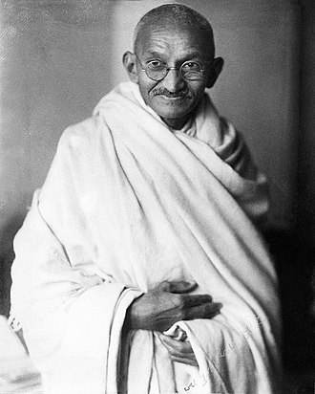
Mahatma Ghandi
(1869 – 1948)
“The weak can never forgive. Forgiveness is the attribute of the strong”
- Mahatma Ghandi.

Slide 26
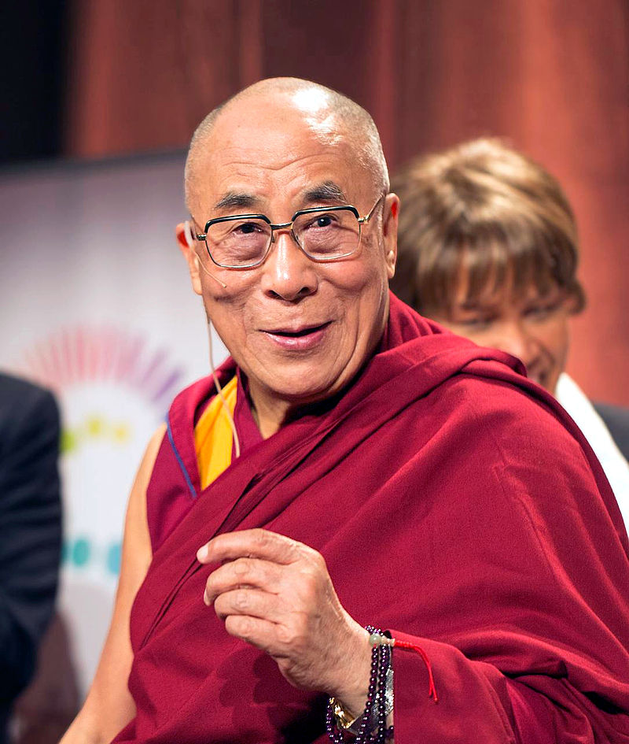
Dalai Lama
(1935 – )
“Compassion and Forgiveness are the ultimate sources of power for peace and success in life”
- Dalai Lama.

Slide 27
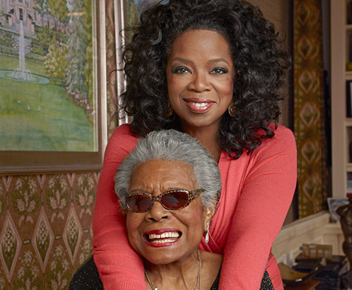
Maya Angelou (1928 – 2014)
“The greatest lesson that I have learnt in my life is knowing how to forgive and let go.”
- Maya Angelou.

Slide 28
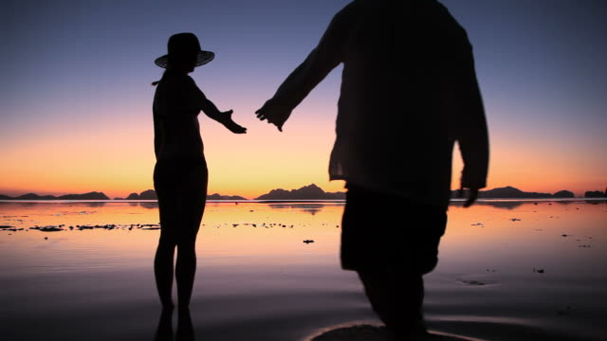
HOANI – A CASE STUDY

Slide 29
SO HOW DO WE FORGIVE?

Slide 30
THE WAIRUA ORA FORGIVENESS MODEL

Slide 31
1. The Wairua Ora Model will teach you how a willingness to forgive and move on helps you build resilience, healthier relationships and a stronger sense of self. 2. The Wairua Ora Model has Six Steps that clearly breaks down how to forgive, cultivate compassion, release resentment and find peace. 3. The Wairua Ora Model will help teach you the benefits of reducing anger and stress and how it can help you in your work and in your daily life.
A FORGIVENESS MODEL TO FOLLOW

Slide 32
THE
WAIRUA ORA
HEALING & FORGIVENESS MODEL
(6 STEPS)

Slide 33
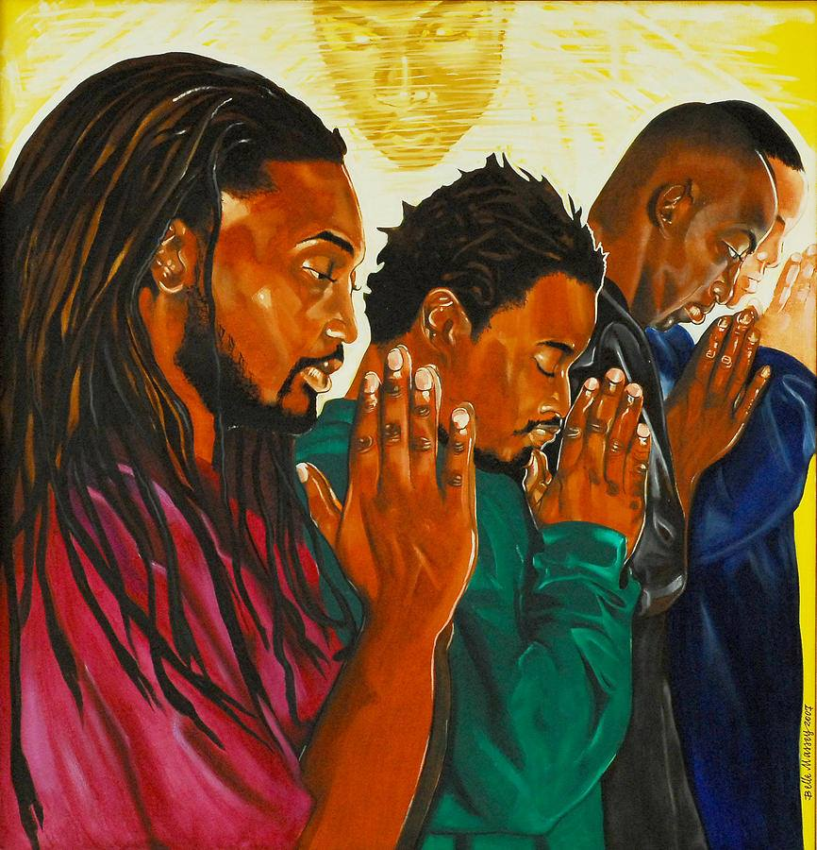
STEP 1
TAPAE, RIPENETA
SPIRITUALLY CLEANSE OURSELVES

Slide 34
STEP 2
MĀ TE KÔRERO, KA ORA
SHARE YOUR STORY –
SPEAK YOUR TRUTH

Slide 35
STEP 3
KEI HEA
TE MAMAE?
IDENTIFY WHERE IT HURTS.

Slide 36
STEP 4
KO TE WĀ WHAKAARO?
DECISION TIME – CHOOSING TO FORGIVE.

Slide 37
STEP 5
WHAKAWETE,
WHAKAHOU
RĀNEI
RELEASE OR
RENEW
RELATIONSHIP

Slide 38
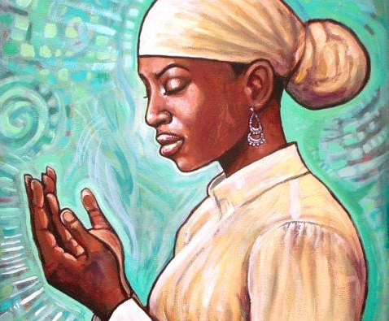
STEP 6
INOI PAPA
NGĀKAU
A PRAYER FROM THE HEART TO CLOSE PROCESS

Slide 39
A FORGIVENESS EXERCISE
(Ho’oponopono)

Slide 40
IN CONCLUSION

Slide 41
WAIRUA ORA
HEALING TRAUMA thru FORGIVENESS WORKSHOPS
www.wairuaora.com

Slide 42
PUREA NEI
Purea nei e te hau Horoia e te ua Whitiwhitia e te rā Mahea ake ngā pōraruraru Makere ana ngā here. | Cleansed by the wind washed by the rain and warmed by the sun, all troubles are cleared away and all restraints got rid of.
E rere wairua, e rere Ki ngā ao o te rangi Whitiwhitia e te rā Mahea ake ngā pōraruraru Makere ana ngā here, Makere ana ngā here. | Fly O free spirit, fly to the clouds in the heavens, warmed by the sun, with all troubles cleared away all restraints got rid of, all restrictions cast aside.

