Slide 1
INSIGHTS FROM THE
ITS NOT OK CAMPAIGN
Brian Gardner - Lead Advisor - Social Action Team

Slide 2
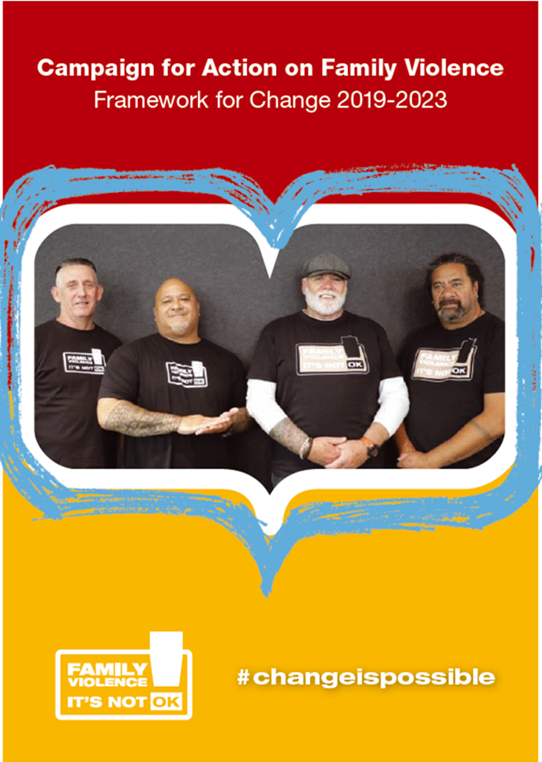
Campaign for Action on Family Violence
Review
Know your lane, work better within system
Build on gains
Go back to strong theories of change, evaluation
Focus on the greatest need
Work differently
Go where people are, partner
Move from broadcast messaging to influence and disruption

Slide 3
WHAT IS SOCIAL ACTION?
PREVENTION
SOCIAL CHANGE
Universal protections
Societal, cultural, economic, environmental factors that drive and reinforce harm
Public health (2.0)
Using marketing, community mobilisation, capability building to influence, drive positive change – behavior change, social norms

Slide 4
THE SOCIAL ACTION TEAM
Campaign for Action on Family Violence
#LoveBetter
Prevention of Abuse of Older People

Slide 5
WE RECOGNISED A NEED TO SHIFT FROM BROADCAST MESSAGING TO INFLUENCE AND DISRUPTION. TO GO WHERE THE PEOPLE ARE AND PARTNER WITH THEM.

Slide 6
DISCOVERY
Understanding the environments and conditions that support men to be violence free and how we grow those conditions.

Slide 7
HOW WE UNDERSTOOD THE CONDITIONS THAT SUPPORT CHANGE.
What are the conditions that enable men to be and stay violence free?
What are the conditions that hinder men to be and stay violence free?
How might we positively impact or support these conditions to grow?

Slide 8
HERE’S WHAT WE LEARNED ...

Slide 9
What Men Told Us
Men want to feel hopeful, and know that change is possible
They want to be able to access information and support easily, and when they need
They want safe environments with men who have made changes and won’t judge
They are drawn to new ideas, skill & growth

Slide 10
What Men Told Us
Use Te Ao Māori and other cultural models of change
People and principles – ahua and wairua –indigenous approaches
Shift from a “violence first conversation”
Understanding & addressing their trauma and healing needs
Do the simple things to stay well- “6 pillars of well being”
Notes:
Sleep, light, nutrition, movement, positive social connection, stress control

Slide 11
Barriers to Change
Relevance – is this me? am I abusive or violent?
Trust – what will happen if I open up, will I lose my partner, kids, family, friends and job?
Shame – I am bad and unlovable
Self medicating trauma and hurt with alcohol and drugs
Harmful gender norms and attitudes that underpin violence

Slide 12
Barriers to Change (cont.)
Harmful male norms
Its hard to know where to get support
Colonisation cultural dislocation
Poverty, inequality, racism lack of access to support
An approach that is punitive and only “calls out” doesn’t
call men in
Covid, climate change

Slide 13
Influencing & Enabling Change
More supportive conditions and environments that enable men to seek help, be vulnerable and challenge harmful masculinity
More men as “Changemakers”
Encouraging men’s help seeking –call change ready men in
Support when you need it for as long as you need it
Access to people, tools and skills to support change
Notes:
Both government and community conditions and environments
focus on change ready men we need effective Justice responses for those men who are dangerous, minimizing, denying, blaming.

Slide 14
THANK YOU
& QUESTIONS.

