Slide 1



UNDERSTANDING FINANCES SERIES
Reading Financial Reports
28 July 2023

Slide 2
INTRODUCTIONS
Both governance and management team members should be able to read and understand a number of key financial reports.
No one report will provide sufficient information to give a good overall picture of your financial position. The following reports together will provide information to assist you to make sound financial decisions:
Balance Sheet
Profit & Loss Report
Cash Flow Statement

Slide 3
WHAT’S IN A BALANCE SHEET?
A Balance Sheet is a financial statement that reports a company's assets, liabilities, and equity at a specific point in time.
It provides an overview of the state of an organisation’s finances at a moment in time. On its own, it cannot give a sense of the trends playing out over a longer period.
Recommendations:
Reconciliations should be as up to date as possible to ensure
accuracy prior to running a Balance Sheet
Compare current period with previous period/s for context
Check and question anything that doesn’t look right
Xero Tip
Click on any fields in “blue” and this will take you to the source of the amount being reported
Notes:
Keep standard documents in central location where everyone can access.
Performance Report
Submitted in format required by Charities services, completing all sections
Signed off by organisation
Audit Report attached if your organisation is required to be audited
Don’t submit any other documents i.e. minutes
Rules
Make sure any rule changes have been signed off according to the rules of your organisation and then registered i.e If Incorporated Society and registered Charity. File changes first with Incorporated Societies through Companies Office. Once rule change has been approved file updated and approved rules with Charities.
Support
Case Studies using Client Profiles or similar. Check with client and make sure information does not lead to person being able to be identified
Letters of support for your service, a particular programme or project. i.e Letters of Support for a building project could be from individuals or other organisations who would use the new / renovated building
Template Documents
Client Profile template for Case Study
Standard Details template
About Us Summary

Slide 4
BALANCE SHEET - TERMS & DEFINITIONS
Term | Definition | Notes & Examples
Asset | Anything that has a current or future economic value
Current Asset | Assets which can be converted to cash in one year or less | Current bank account / Savings Account, Term Deposit/s, Accounts Receivable
Accounts Receivable | Money that is owed to the organisation. Invoices you have issued and payment hasn’t yet been received. | Figures include GST if your organisation is GST registered
Fixed Asset | Bigger assets over $1,000 +GST which can be depreciated * * Doesn’t apply to NFP and/or Charities with tax exemption collate assets from management perspective | Land, machinery, equipment, buildings, computer equipment, vehicles
Non-current Asset | Non-physical (but still valuable) assets | Website, branding, intellectual property
Liability | Money that an organisation owes to outside parties
Current Liability | Amounts due to be paid to creditors (outside parties) within twelve months. | Accounts Payable, GST Payable to IRD, Holiday Pay due to employees, Unexpended Grants payable to funders if grant / contract conditions not able to be met
Accounts Payable | Money owed to suppliers / providers. Bills loaded but not yet paid by your organisations | Figures include GST if the supplier is GST registered
Notes:
Keep standard documents in central location where everyone can access.
Performance Report
Submitted in format required by Charities services, completing all sections
Signed off by organisation
Audit Report attached if your organisation is required to be audited
Don’t submit any other documents i.e. minutes
Rules
Make sure any rule changes have been signed off according to the rules of your organisation and then registered i.e If Incorporated Society and registered Charity. File changes first with Incorporated Societies through Companies Office. Once rule change has been approved file updated and approved rules with Charities.
Support
Case Studies using Client Profiles or similar. Check with client and make sure information does not lead to person being able to be identified
Letters of support for your service, a particular programme or project. i.e Letters of Support for a building project could be from individuals or other organisations who would use the new / renovated building
Template Documents
Client Profile template for Case Study
Standard Details template
About Us Summary

Slide 5
BALANCE SHEET - TERMS & DEFINITIONS
Term | Definition | Notes & Examples
GST | GST Payable or GST Refund if amount preceded by “-”
Holiday Pay Liability | Accrued annual leave for staff | Total amount of accrued leave payable if staff members were to leave or the organisation was wound up
Suspense | An account that temporarily records amounts that are yet to have their proper accounts determined or aren’t to be included in accounts | Money paid to you in error that needs to be returned, wrong card used and amount to be repaid
Unexpended Grants | Grants / Contract funds received but not yet accounted for to the funder | Until funding terms and conditions have been met and any reporting requirements completed / accepted you may need to return the funds.
Net Assets | Total Assets less Liabilities | “Net Assets” amount should equal “Total Equity”
Equity | Total value of your Assets less the sum of your Liabilities | If your organisation were to stop operating tomorrow and all of your assets were to be liquidated, your equity would be the amount that is left
Current Year Earnings | “Net Profit” from Profit & Loss Report
Retained Earnings | Accumulated “Net Profit” from previous years Profit & Loss Reports
Notes:
Keep standard documents in central location where everyone can access.
Performance Report
Submitted in format required by Charities services, completing all sections
Signed off by organisation
Audit Report attached if your organisation is required to be audited
Don’t submit any other documents i.e. minutes
Rules
Make sure any rule changes have been signed off according to the rules of your organisation and then registered i.e If Incorporated Society and registered Charity. File changes first with Incorporated Societies through Companies Office. Once rule change has been approved file updated and approved rules with Charities.
Support
Case Studies using Client Profiles or similar. Check with client and make sure information does not lead to person being able to be identified
Letters of support for your service, a particular programme or project. i.e Letters of Support for a building project could be from individuals or other organisations who would use the new / renovated building
Template Documents
Client Profile template for Case Study
Standard Details template
About Us Summary

Slide 6
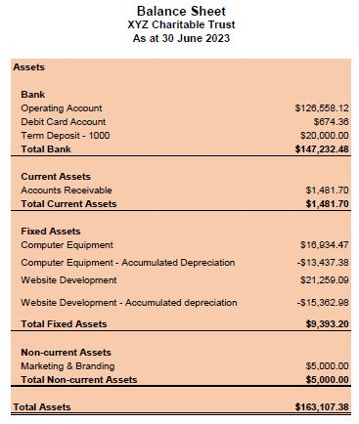
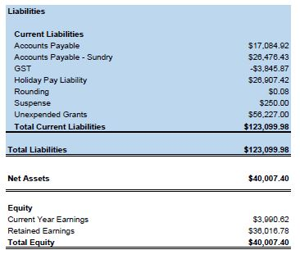
BALANCE SHEET - EXAMPLE
Notes:
Keep standard documents in central location where everyone can access.
Performance Report
Submitted in format required by Charities services, completing all sections
Signed off by organisation
Audit Report attached if your organisation is required to be audited
Don’t submit any other documents i.e. minutes
Rules
Make sure any rule changes have been signed off according to the rules of your organisation and then registered i.e If Incorporated Society and registered Charity. File changes first with Incorporated Societies through Companies Office. Once rule change has been approved file updated and approved rules with Charities.
Support
Case Studies using Client Profiles or similar. Check with client and make sure information does not lead to person being able to be identified
Letters of support for your service, a particular programme or project. i.e Letters of Support for a building project could be from individuals or other organisations who would use the new / renovated building
Template Documents
Client Profile template for Case Study
Standard Details template
About Us Summary

Slide 7

RED FLAGS & POSSIBLE ACTION
“Total Bank” + “Accounts Receivable” balance is less than your “Liabilities”
  Encourage staff to take annual leave to reduce your Leave Liability
  Review up and coming expenses and reduce spending where possible
2. “GST” payable amount is larger than expected
  Check GST allocation of income and expenses for the current period. Has GST been allocated correctly? If not, correct GST and update Balance Sheet
3. “Suspense” entry doesn’t revert to zero
  Investigate suspense entries to see if transaction needs to be coded to an expense account or when corresponding debit / credit entry is expected to zero out original suspense entry
4. Significant changes to Assets & Liabilities year over year
  Is there a known reason for this change i.e planned expansion? If not, investigate further so that you know why
Notes:
Keep standard documents in central location where everyone can access.
Performance Report
Submitted in format required by Charities services, completing all sections
Signed off by organisation
Audit Report attached if your organisation is required to be audited
Don’t submit any other documents i.e. minutes
Rules
Make sure any rule changes have been signed off according to the rules of your organisation and then registered i.e If Incorporated Society and registered Charity. File changes first with Incorporated Societies through Companies Office. Once rule change has been approved file updated and approved rules with Charities.
Support
Case Studies using Client Profiles or similar. Check with client and make sure information does not lead to person being able to be identified
Letters of support for your service, a particular programme or project. i.e Letters of Support for a building project could be from individuals or other organisations who would use the new / renovated building
Template Documents
Client Profile template for Case Study
Standard Details template
About Us Summary

Slide 8
WHAT’S IN A PROFIT & LOSS REPORT?
Profit & Loss Reports are also known as income statements.
Use the Profit and Loss report to see a snapshot of your organisation’s income, expenses and profit for a specific period.
The Profit and Loss report displays accounts with an income and expense account type and reports exclusive of GST.
Recommendations:
Reconciliations should be as up to date as possible to ensure
accuracy prior to running a Profit & Loss Report
Compare current period with previous period/s for context
Compare Actuals to Budget entered to see how you are tracking throughout the year
NOTE
Profit & Loss Report doesn’t include fixed assets purchased
Notes:
Keep standard documents in central location where everyone can access.
Performance Report
Submitted in format required by Charities services, completing all sections
Signed off by organisation
Audit Report attached if your organisation is required to be audited
Don’t submit any other documents i.e. minutes
Rules
Make sure any rule changes have been signed off according to the rules of your organisation and then registered i.e If Incorporated Society and registered Charity. File changes first with Incorporated Societies through Companies Office. Once rule change has been approved file updated and approved rules with Charities.
Support
Case Studies using Client Profiles or similar. Check with client and make sure information does not lead to person being able to be identified
Letters of support for your service, a particular programme or project. i.e Letters of Support for a building project could be from individuals or other organisations who would use the new / renovated building
Template Documents
Client Profile template for Case Study
Standard Details template
About Us Summary

Slide 9
PROFIT & LOSS REPORT - TERMS & DEFINITIONS
Term | Definition | Notes & Examples
Income | Revenue into your organisation | Donations, Registrations, Grants, Sales, Interest Income
Cost of Sales | Expense codes related directly to the cost of goods sold | Production, manufacturing costs
Other Income | Additional income that doesn’t fit into main income categories | Grants received in advance
Gross Profit | Gross profit is the money you have left after paying for the things you sold to customers. | Total income less Cost of Sales - Gross Profit You don’t get to keep the gross profit. You still need to pay other operating expenses and taxes from this pot of money.
Operating Expenses | Operating expenses (often shortened to OpEx) are the costs of doing business. | Operating Expenses are commonly divided into the following categories in your chart of accounts: Direct Costs (Cost of Goods Sold / Cost of Sales) Expenses Overheads
Net Profit | Net Profit = Gross Profit less expenses
Notes:
Keep standard documents in central location where everyone can access.
Performance Report
Submitted in format required by Charities services, completing all sections
Signed off by organisation
Audit Report attached if your organisation is required to be audited
Don’t submit any other documents i.e. minutes
Rules
Make sure any rule changes have been signed off according to the rules of your organisation and then registered i.e If Incorporated Society and registered Charity. File changes first with Incorporated Societies through Companies Office. Once rule change has been approved file updated and approved rules with Charities.
Support
Case Studies using Client Profiles or similar. Check with client and make sure information does not lead to person being able to be identified
Letters of support for your service, a particular programme or project. i.e Letters of Support for a building project could be from individuals or other organisations who would use the new / renovated building
Template Documents
Client Profile template for Case Study
Standard Details template
About Us Summary

Slide 10
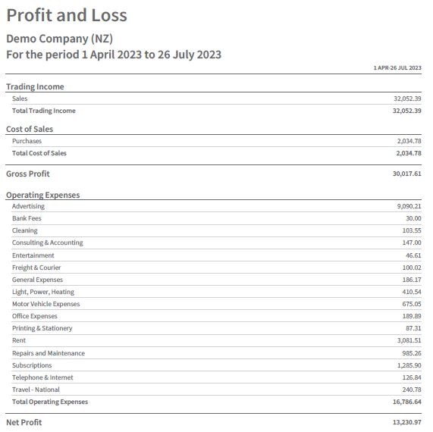
PROFIT & LOSS REPORT - EXAMPLE
Notes:
Keep standard documents in central location where everyone can access.
Performance Report
Submitted in format required by Charities services, completing all sections
Signed off by organisation
Audit Report attached if your organisation is required to be audited
Don’t submit any other documents i.e. minutes
Rules
Make sure any rule changes have been signed off according to the rules of your organisation and then registered i.e If Incorporated Society and registered Charity. File changes first with Incorporated Societies through Companies Office. Once rule change has been approved file updated and approved rules with Charities.
Support
Case Studies using Client Profiles or similar. Check with client and make sure information does not lead to person being able to be identified
Letters of support for your service, a particular programme or project. i.e Letters of Support for a building project could be from individuals or other organisations who would use the new / renovated building
Template Documents
Client Profile template for Case Study
Standard Details template
About Us Summary

Slide 11
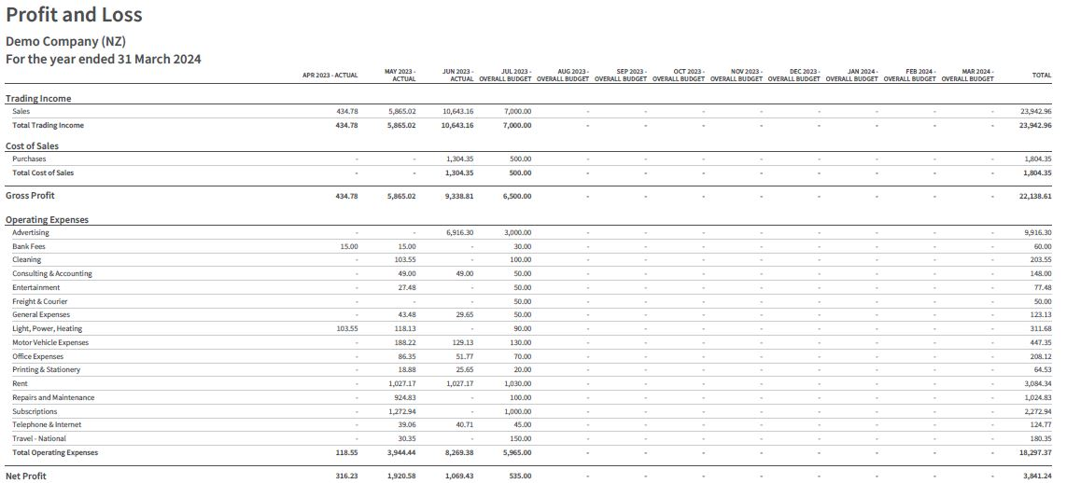
BUDGET AND ACTUAL
Notes:
Keep standard documents in central location where everyone can access.
Performance Report
Submitted in format required by Charities services, completing all sections
Signed off by organisation
Audit Report attached if your organisation is required to be audited
Don’t submit any other documents i.e. minutes
Rules
Make sure any rule changes have been signed off according to the rules of your organisation and then registered i.e If Incorporated Society and registered Charity. File changes first with Incorporated Societies through Companies Office. Once rule change has been approved file updated and approved rules with Charities.
Support
Case Studies using Client Profiles or similar. Check with client and make sure information does not lead to person being able to be identified
Letters of support for your service, a particular programme or project. i.e Letters of Support for a building project could be from individuals or other organisations who would use the new / renovated building
Template Documents
Client Profile template for Case Study
Standard Details template
About Us Summary

Slide 12
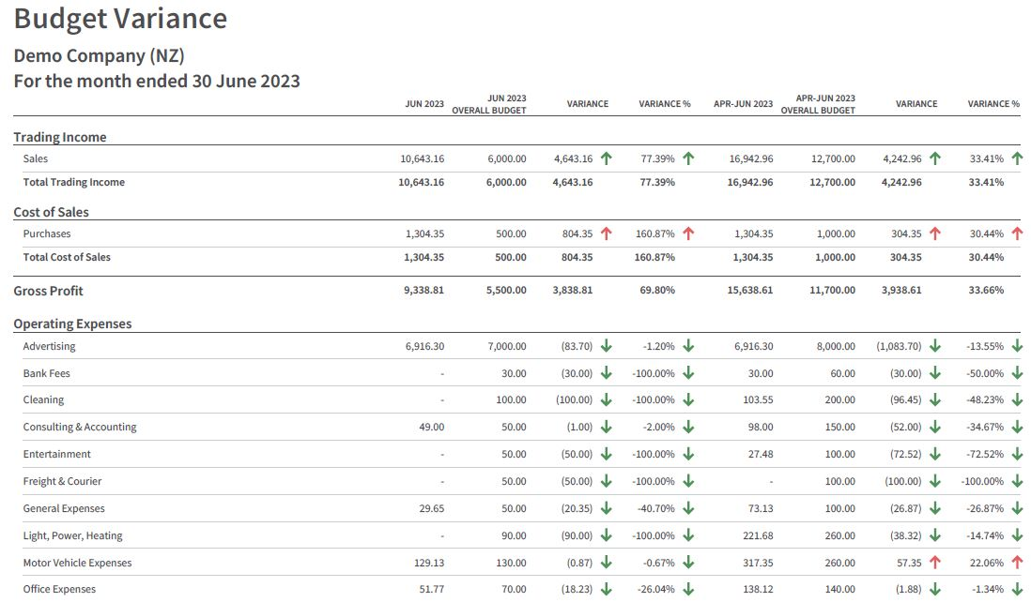
BUDGET VARIANCE
Notes:
Keep standard documents in central location where everyone can access.
Performance Report
Submitted in format required by Charities services, completing all sections
Signed off by organisation
Audit Report attached if your organisation is required to be audited
Don’t submit any other documents i.e. minutes
Rules
Make sure any rule changes have been signed off according to the rules of your organisation and then registered i.e If Incorporated Society and registered Charity. File changes first with Incorporated Societies through Companies Office. Once rule change has been approved file updated and approved rules with Charities.
Support
Case Studies using Client Profiles or similar. Check with client and make sure information does not lead to person being able to be identified
Letters of support for your service, a particular programme or project. i.e Letters of Support for a building project could be from individuals or other organisations who would use the new / renovated building
Template Documents
Client Profile template for Case Study
Standard Details template
About Us Summary

Slide 13
RED FLAGS & POSSIBLE ACTION
End of year result from Budget and Actual Report predicts a deficit
  Take planned approach to increasing income and / or decreasing expenses
  Submit updated budget to board for approval if necessary
2. Budget Variance Report variances report - Income or Expenses
  Investigate reason for reduction in income and plan corrective action if needed
  Investigate reason for increase in expenses and plan corrective action if needed
NOTE
Unexpended grants may need to be deducted from “Net Profit” if monthly adjustments are not being made
Notes:
Keep standard documents in central location where everyone can access.
Performance Report
Submitted in format required by Charities services, completing all sections
Signed off by organisation
Audit Report attached if your organisation is required to be audited
Don’t submit any other documents i.e. minutes
Rules
Make sure any rule changes have been signed off according to the rules of your organisation and then registered i.e If Incorporated Society and registered Charity. File changes first with Incorporated Societies through Companies Office. Once rule change has been approved file updated and approved rules with Charities.
Support
Case Studies using Client Profiles or similar. Check with client and make sure information does not lead to person being able to be identified
Letters of support for your service, a particular programme or project. i.e Letters of Support for a building project could be from individuals or other organisations who would use the new / renovated building
Template Documents
Client Profile template for Case Study
Standard Details template
About Us Summary

Slide 14
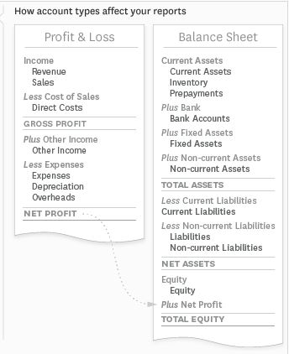
BALANCE SHEET VS PROFIT & LOSS
Notes:
Keep standard documents in central location where everyone can access.
Performance Report
Submitted in format required by Charities services, completing all sections
Signed off by organisation
Audit Report attached if your organisation is required to be audited
Don’t submit any other documents i.e. minutes
Rules
Make sure any rule changes have been signed off according to the rules of your organisation and then registered i.e If Incorporated Society and registered Charity. File changes first with Incorporated Societies through Companies Office. Once rule change has been approved file updated and approved rules with Charities.
Support
Case Studies using Client Profiles or similar. Check with client and make sure information does not lead to person being able to be identified
Letters of support for your service, a particular programme or project. i.e Letters of Support for a building project could be from individuals or other organisations who would use the new / renovated building
Template Documents
Client Profile template for Case Study
Standard Details template
About Us Summary

Slide 15
WHAT’S IN A CASH FLOW STATEMENT?
A cash flow statement is a financial report that shows where a business’s money is coming from and where it’s going. It’s also known as a Statement of Cash Flows
A Cash Flow Statement shows which parts of the organisation generated cash and which parts spent cash during a given period of time. It helps show if an organisation has any trouble meeting its expenses.
What it tracks: Cash in and out of the business
What it tells you: Whether cash is going out faster than it comes in and whether the organisataion can pay its expenses
Notes:
Keep standard documents in central location where everyone can access.
Performance Report
Submitted in format required by Charities services, completing all sections
Signed off by organisation
Audit Report attached if your organisation is required to be audited
Don’t submit any other documents i.e. minutes
Rules
Make sure any rule changes have been signed off according to the rules of your organisation and then registered i.e If Incorporated Society and registered Charity. File changes first with Incorporated Societies through Companies Office. Once rule change has been approved file updated and approved rules with Charities.
Support
Case Studies using Client Profiles or similar. Check with client and make sure information does not lead to person being able to be identified
Letters of support for your service, a particular programme or project. i.e Letters of Support for a building project could be from individuals or other organisations who would use the new / renovated building
Template Documents
Client Profile template for Case Study
Standard Details template
About Us Summary

Slide 16
CASH FLOW STATEMENT - TERMS & DEFINITIONS
Term | Definition | Notes & Examples
Operating Activities | Net Cash Flows from Operating Activities | Receipts from Customers, less Payments to Suppliers plus Cash receipts from other operating activities i.e GST, adjustments for Grants Received in Advance
Investing Activities | Net Cash Flows from Investing Activities | Fixed Asset purchases
Financing Activities | Net Cash Flows from Financing Activities | Adjustments for Holiday pay accruals, Unexpended Grants, Rounding, Suspense
Net Cash Flows | Operating Activities +/- Investing and Financing Activities
Cash and Cash Equivalents | Cash and cash equivalents at beginning of period = bank account total at the beginning of the period Cash and cash equivalents at end of period = bank account total at the end of the period | Funds in the bank at the beginning and end of each month
Net Change in cash for the period | Net Cash Flows from Operating Activities +/- Investing and Financing Activities
Notes:
Keep standard documents in central location where everyone can access.
Performance Report
Submitted in format required by Charities services, completing all sections
Signed off by organisation
Audit Report attached if your organisation is required to be audited
Don’t submit any other documents i.e. minutes
Rules
Make sure any rule changes have been signed off according to the rules of your organisation and then registered i.e If Incorporated Society and registered Charity. File changes first with Incorporated Societies through Companies Office. Once rule change has been approved file updated and approved rules with Charities.
Support
Case Studies using Client Profiles or similar. Check with client and make sure information does not lead to person being able to be identified
Letters of support for your service, a particular programme or project. i.e Letters of Support for a building project could be from individuals or other organisations who would use the new / renovated building
Template Documents
Client Profile template for Case Study
Standard Details template
About Us Summary

Slide 17
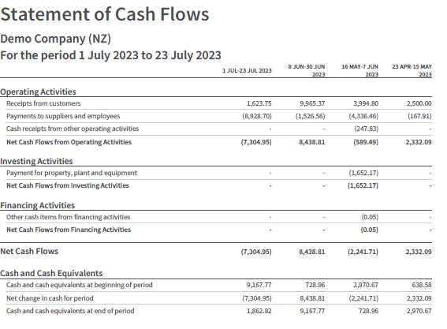
CASH FLOW STATEMENT - EXAMPLE
Notes:
Keep standard documents in central location where everyone can access.
Performance Report
Submitted in format required by Charities services, completing all sections
Signed off by organisation
Audit Report attached if your organisation is required to be audited
Don’t submit any other documents i.e. minutes
Rules
Make sure any rule changes have been signed off according to the rules of your organisation and then registered i.e If Incorporated Society and registered Charity. File changes first with Incorporated Societies through Companies Office. Once rule change has been approved file updated and approved rules with Charities.
Support
Case Studies using Client Profiles or similar. Check with client and make sure information does not lead to person being able to be identified
Letters of support for your service, a particular programme or project. i.e Letters of Support for a building project could be from individuals or other organisations who would use the new / renovated building
Template Documents
Client Profile template for Case Study
Standard Details template
About Us Summary

Slide 18
RED FLAGS & POSSIBLE ACTION
Consistent Net Cash Flow deficits (shown by brackets). This means there is consistently more money leaving your account than is coming in
  Prepare a Cashflow Forecast with known income and predicted expenses to see if you will have enough funds to continue to operate for the next 6 - 12 months
  Use the “Average” figures from the Cash Summary Report (Gross amount selected) to predict future spending based on actual past expenditure
Notes:
Keep standard documents in central location where everyone can access.
Performance Report
Submitted in format required by Charities services, completing all sections
Signed off by organisation
Audit Report attached if your organisation is required to be audited
Don’t submit any other documents i.e. minutes
Rules
Make sure any rule changes have been signed off according to the rules of your organisation and then registered i.e If Incorporated Society and registered Charity. File changes first with Incorporated Societies through Companies Office. Once rule change has been approved file updated and approved rules with Charities.
Support
Case Studies using Client Profiles or similar. Check with client and make sure information does not lead to person being able to be identified
Letters of support for your service, a particular programme or project. i.e Letters of Support for a building project could be from individuals or other organisations who would use the new / renovated building
Template Documents
Client Profile template for Case Study
Standard Details template
About Us Summary

Slide 19
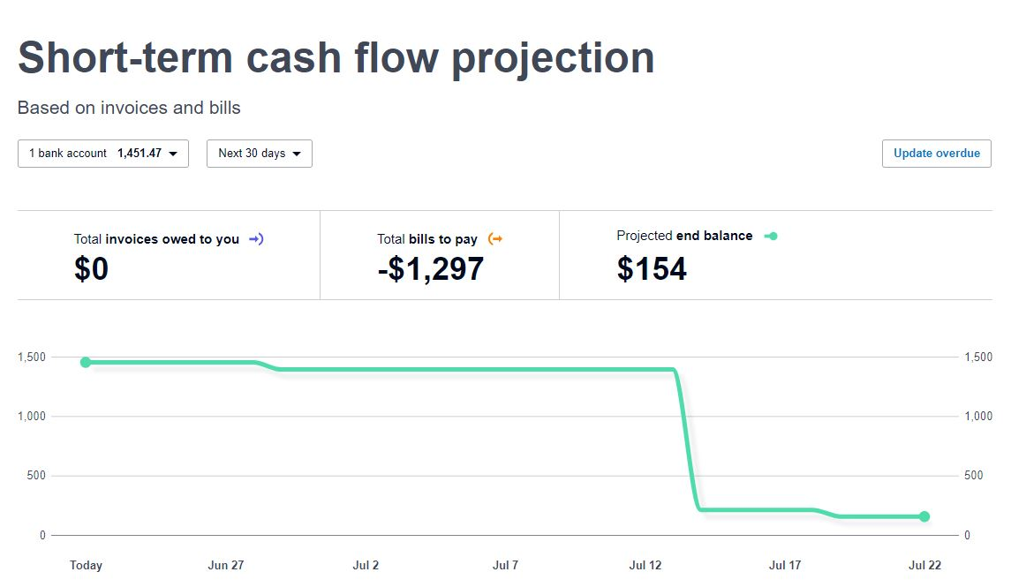
XERO - SHORT TERM CASHFLOW
Xero Dashboard - Business / Short-term cash flow
Ability to update expected income and expenses
Maximum projection period 30 days.
Additional periods available through Analytics Plus
Notes:
Keep standard documents in central location where everyone can access.
Performance Report
Submitted in format required by Charities services, completing all sections
Signed off by organisation
Audit Report attached if your organisation is required to be audited
Don’t submit any other documents i.e. minutes
Rules
Make sure any rule changes have been signed off according to the rules of your organisation and then registered i.e If Incorporated Society and registered Charity. File changes first with Incorporated Societies through Companies Office. Once rule change has been approved file updated and approved rules with Charities.
Support
Case Studies using Client Profiles or similar. Check with client and make sure information does not lead to person being able to be identified
Letters of support for your service, a particular programme or project. i.e Letters of Support for a building project could be from individuals or other organisations who would use the new / renovated building
Template Documents
Client Profile template for Case Study
Standard Details template
About Us Summary

Slide 20
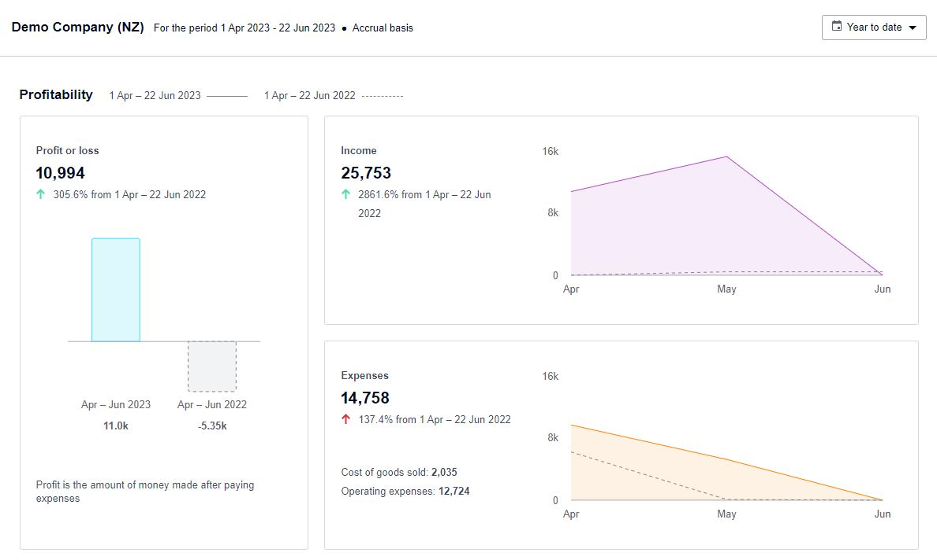
XERO - SHORT TERM CASHFLOW
Xero Dashboard - Business / Business Snapshot
Select period to view
Notes:
Keep standard documents in central location where everyone can access.
Performance Report
Submitted in format required by Charities services, completing all sections
Signed off by organisation
Audit Report attached if your organisation is required to be audited
Don’t submit any other documents i.e. minutes
Rules
Make sure any rule changes have been signed off according to the rules of your organisation and then registered i.e If Incorporated Society and registered Charity. File changes first with Incorporated Societies through Companies Office. Once rule change has been approved file updated and approved rules with Charities.
Support
Case Studies using Client Profiles or similar. Check with client and make sure information does not lead to person being able to be identified
Letters of support for your service, a particular programme or project. i.e Letters of Support for a building project could be from individuals or other organisations who would use the new / renovated building
Template Documents
Client Profile template for Case Study
Standard Details template
About Us Summary

Slide 21
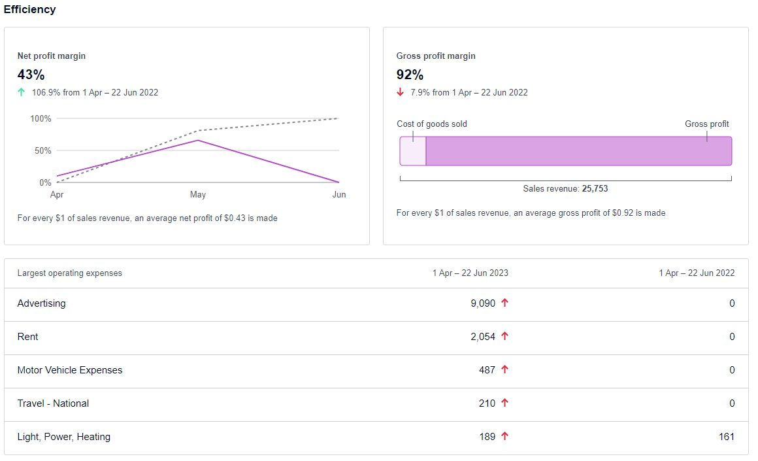
XERO - SHORT TERM CASHFLOW
Xero Dashboard - Business / Business Snapshot
Largest Operating Expenses
Current Year
Prior Year
Notes:
Keep standard documents in central location where everyone can access.
Performance Report
Submitted in format required by Charities services, completing all sections
Signed off by organisation
Audit Report attached if your organisation is required to be audited
Don’t submit any other documents i.e. minutes
Rules
Make sure any rule changes have been signed off according to the rules of your organisation and then registered i.e If Incorporated Society and registered Charity. File changes first with Incorporated Societies through Companies Office. Once rule change has been approved file updated and approved rules with Charities.
Support
Case Studies using Client Profiles or similar. Check with client and make sure information does not lead to person being able to be identified
Letters of support for your service, a particular programme or project. i.e Letters of Support for a building project could be from individuals or other organisations who would use the new / renovated building
Template Documents
Client Profile template for Case Study
Standard Details template
About Us Summary

Slide 22
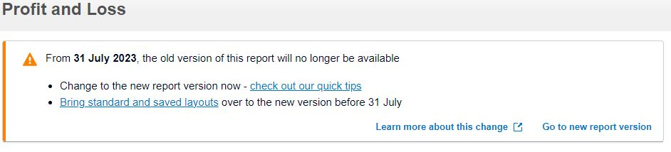
XERO - NEW REPORTS
Notes:
Keep standard documents in central location where everyone can access.
Performance Report
Submitted in format required by Charities services, completing all sections
Signed off by organisation
Audit Report attached if your organisation is required to be audited
Don’t submit any other documents i.e. minutes
Rules
Make sure any rule changes have been signed off according to the rules of your organisation and then registered i.e If Incorporated Society and registered Charity. File changes first with Incorporated Societies through Companies Office. Once rule change has been approved file updated and approved rules with Charities.
Support
Case Studies using Client Profiles or similar. Check with client and make sure information does not lead to person being able to be identified
Letters of support for your service, a particular programme or project. i.e Letters of Support for a building project could be from individuals or other organisations who would use the new / renovated building
Template Documents
Client Profile template for Case Study
Standard Details template
About Us Summary

Slide 23
USEFUL SITES
Baker Tilly Staples Rodway
https://bakertillysr.nz/locations/tauranga/
Business.govt.nz
How to Read Financial Statements
www.business.govt.nz/business-performance/strategic-finance/how-to-read-financial-statements/
CommunityNet Aotearoa
How to Read Financial Statements
https://community.net.nz/resources/nz-navigator-trust/how-to-read-financial-statements/
Xero
What is a Financial Statement
https://www.xero.com/nz/glossary/financial-statement/
Notes:
Keep standard documents in central location where everyone can access.
Performance Report
Submitted in format required by Charities services, completing all sections
Signed off by organisation
Audit Report attached if your organisation is required to be audited
Don’t submit any other documents i.e. minutes
Rules
Make sure any rule changes have been signed off according to the rules of your organisation and then registered i.e If Incorporated Society and registered Charity. File changes first with Incorporated Societies through Companies Office. Once rule change has been approved file updated and approved rules with Charities.
Support
Case Studies using Client Profiles or similar. Check with client and make sure information does not lead to person being able to be identified
Letters of support for your service, a particular programme or project. i.e Letters of Support for a building project could be from individuals or other organisations who would use the new / renovated building
Template Documents
Client Profile template for Case Study
Standard Details template
About Us Summary

Slide 24
NEXT WORKSHOPS
GST & Payroll
25 August
Annual Financial Statements
22 September

