Slide 1




UNDERSTANDING FINANCES
GST & Payroll
25 August 2023
With special thanks to
for providing on-site support during these workshops

Slide 2
GST REGISTRATION
Your organisation does not have to register for GST just because you have started a business or organisation.
You must register if you are an entity and either of these apply to you:
you carry out a taxable activity and your turnover was at least $60,000 in the last 12 months, or you expect it will be at least $60,000 in the next 12 months
you carry out a taxable activity and you add GST to the price of the goods or services you sell.
When you register for GST you choose how often you file your GST returns (your filing frequency) and how you record your GST (your accounting basis).
https://www.ird.govt.nz/gst/registering-for-gst

Slide 3
GST ACCOUNTING BASIS
Accounting basis | Who’s eligible | What you need to do
Payments | If your total sales are: $2 million or less in the last 12 months likely to be $2 million or less in any 12-month period beginning on the first day of a month. | In your GST return for the period include: amounts you've been paid by customers amounts you've paid to suppliers if you hold taxable supply information.
Invoice | Anyone | In your GST return for the period include: amounts you’ve notified customers to pay by invoice, even if you have not been paid yet the full sale price amount if customers have paid any amount before you’ve invoiced them amounts you’ve paid to or been invoiced by suppliers if you hold taxable supply information, even if you have not paid the full amount yet.
Hybrid | Anyone. Note: This method is not commonly used by small businesses because of negative cashflow consequences. This is because you may return GST on invoiced sales before you have received payment, but you can only claim GST when you have paid for your purchases (not when invoiced). | Use the invoice basis for your sales. Use the payments basis for your expenses.
Most organisations use “Payments” based Accounting
Source: https://www.ird.govt.nz/gst/registering-for-gst/which-gst-accounting-basis-and-filing-frequency-should-i-use

Slide 4
GST FILING FREQUENCY
Filing Frequency | Who’s eligible | Who it’s suitable for
Monthly | Anyone. You must file monthly if your sales are over $24 million in any 12-month period. For a GST group the $24 million applies to the group as a whole. | Customers likely to get regular GST refunds.
Two-monthly | Anyone with sales under $24 million in any 12-month period. For a GST group the $24 million applies to the group as a whole. | Customers who find regular filing helps them keep on top of paperwork.
Six-monthly | Anyone with sales under $500,000 in any 12-month period. For a GST group the $500,000 applies to the group as a whole. | Customers with few sales and purchases. You only need to file two returns a year but it can be a big job to account for six months' worth of trading in one go.
Most organisations use “Two-Monthly” Filing Frequency
Source: https://www.ird.govt.nz/gst/registering-for-gst/which-gst-accounting-basis-and-filing-frequency-should-i-use

Slide 5
INVOICES (Accounts Receivable)
Below is a summary of how GST is applied to Income:
Grants | Contracts | Donations | Other Income | Interest
Generally Grants are exclusive of GST | GST is added to contract amounts | No GST on Donations received | Sale of goods must include a GST component if the group is GST registered Training / workshop fees or registrations must include a GST component if the group is GST registered | No GST on Interest Income
Generally Grants will include GST
Groups GST
Registered
Groups
Not GST
Registered
Record the Gross amount received

Slide 6
INVOICES (Accounts Payable)
Below is a summary of how GST is applied to Expenses:
Bank Fees | Contractors | Koha / Donations | Mileage | Reimbursements | Wages
Bank fees do not have GST | GST is applicable only if the Contractor is GST registered | No GST on Koha / Donations made to individuals or organisations. Vouchers - generally there is no GST. Check the receipt when processing | No GST on mileage reimbursement | GST is applicable only if the supplier is GST registered and you have a GST invoice / receipt | No GST on wages
Groups GST
Registered
Groups Not GST
Registered
Record the Gross amount payable /paid

Slide 7
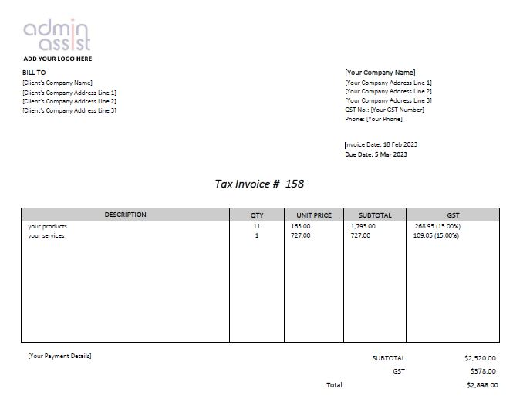

BILLS (Accounts Payable)
GST Number displayed
Dated
Word “Tax Invoice” included
GST amount included
Notes:
Performance Report
Submitted in format required by Charities services, completing all sections
Signed off by organisation
Audit Report attached if your organisation is required to be audited
Don’t submit any other documents i.e. minutes
Rules
Make sure any rule changes have been signed off according to the rules of your organisation and then registered i.e If Incorporated Society and registered Charity. File changes first with Incorporated Societies through Companies Office. Once rule change has been approved file updated and approved rules with Charities.
Support
Case Studies using Client Profiles or similar. Check with client and make sure information does not lead to person being able to be identified
Letters of support for your service, a particular programme or project. i.e Letters of Support for a building project could be from individuals or other organisations who would use the new / renovated building
Template Documents
Client Profile template for Case Study
Standard Details template
About Us Summary

Slide 8
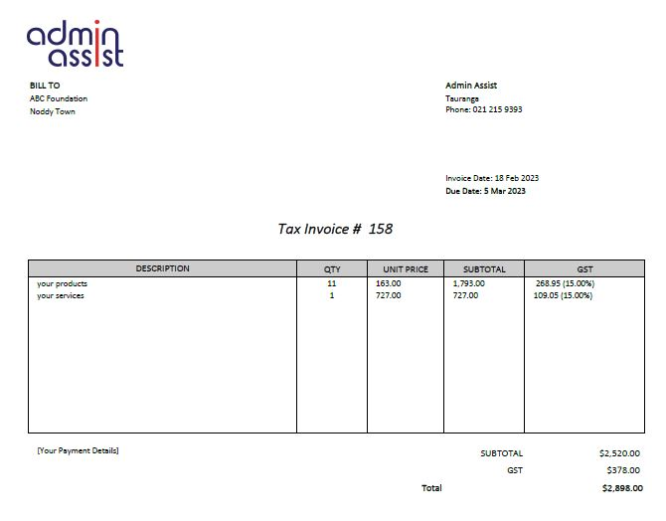

BILLS (Accounts Payable)
No GST Number displayed
Dated
If the Supplier is not GST Registered
No GST number required
No GST charged
“Not registered for GST” should be recorded
If the Supplier is GST Registered
GST number required on bill
GST charged on bill
Word “Tax Invoice” included
GST amount charged but no GST number recorded on the invoice received
Notes:
Performance Report
Submitted in format required by Charities services, completing all sections
Signed off by organisation
Audit Report attached if your organisation is required to be audited
Don’t submit any other documents i.e. minutes
Rules
Make sure any rule changes have been signed off according to the rules of your organisation and then registered i.e If Incorporated Society and registered Charity. File changes first with Incorporated Societies through Companies Office. Once rule change has been approved file updated and approved rules with Charities.
Support
Case Studies using Client Profiles or similar. Check with client and make sure information does not lead to person being able to be identified
Letters of support for your service, a particular programme or project. i.e Letters of Support for a building project could be from individuals or other organisations who would use the new / renovated building
Template Documents
Client Profile template for Case Study
Standard Details template
About Us Summary

Slide 9
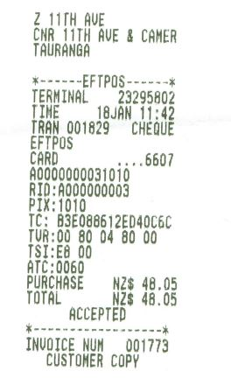
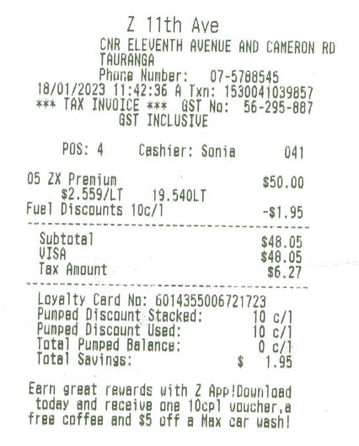
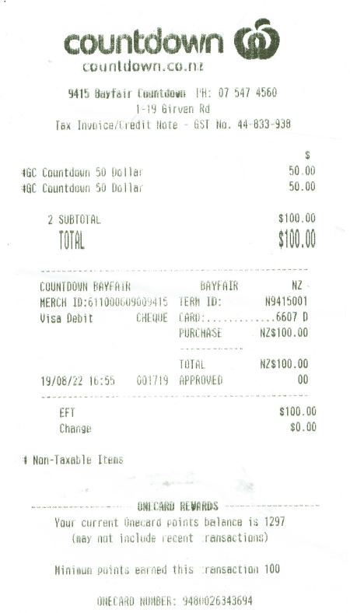
RECEIPTS
Vouchers generally do not have a GST component.
The receipt will confirm if GST is included or not.
Example
# Non-Taxable items
EFTPOS receipt
No GST Number
Not a “Tax Invoice”
GST Number provided
“Tax Invoice” printed
Notes:
Performance Report
Submitted in format required by Charities services, completing all sections
Signed off by organisation
Audit Report attached if your organisation is required to be audited
Don’t submit any other documents i.e. minutes
Rules
Make sure any rule changes have been signed off according to the rules of your organisation and then registered i.e If Incorporated Society and registered Charity. File changes first with Incorporated Societies through Companies Office. Once rule change has been approved file updated and approved rules with Charities.
Support
Case Studies using Client Profiles or similar. Check with client and make sure information does not lead to person being able to be identified
Letters of support for your service, a particular programme or project. i.e Letters of Support for a building project could be from individuals or other organisations who would use the new / renovated building
Template Documents
Client Profile template for Case Study
Standard Details template
About Us Summary

Slide 10
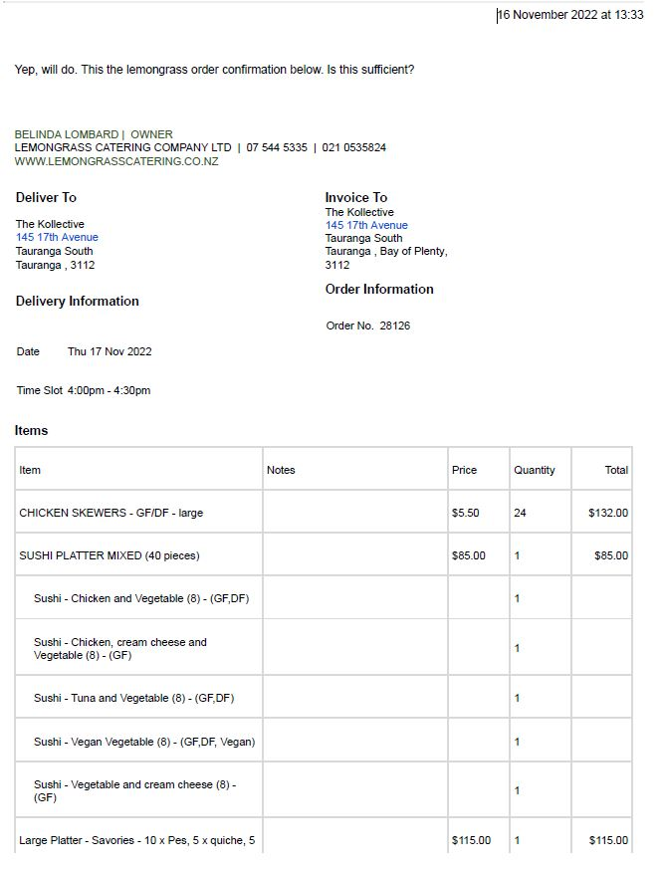
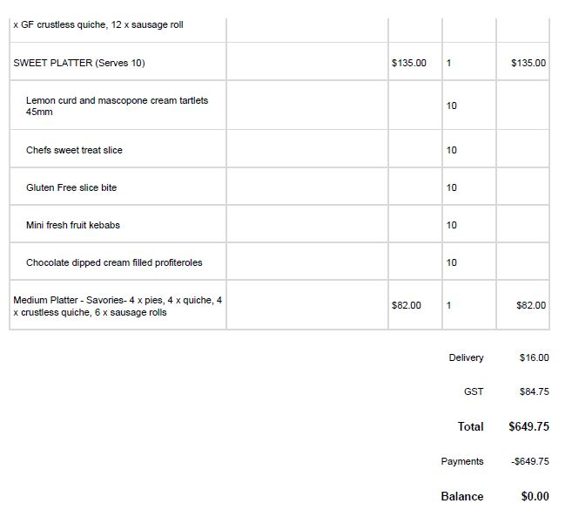
ORDER CONFIRMATION
No GST number
Although the GST amount is shown GST can’t be claimed as the suppliers GST number is not provided.
In this instance ask the supplier to provide a GST Invoice / Receipt
Notes:
Performance Report
Submitted in format required by Charities services, completing all sections
Signed off by organisation
Audit Report attached if your organisation is required to be audited
Don’t submit any other documents i.e. minutes
Rules
Make sure any rule changes have been signed off according to the rules of your organisation and then registered i.e If Incorporated Society and registered Charity. File changes first with Incorporated Societies through Companies Office. Once rule change has been approved file updated and approved rules with Charities.
Support
Case Studies using Client Profiles or similar. Check with client and make sure information does not lead to person being able to be identified
Letters of support for your service, a particular programme or project. i.e Letters of Support for a building project could be from individuals or other organisations who would use the new / renovated building
Template Documents
Client Profile template for Case Study
Standard Details template
About Us Summary

Slide 11
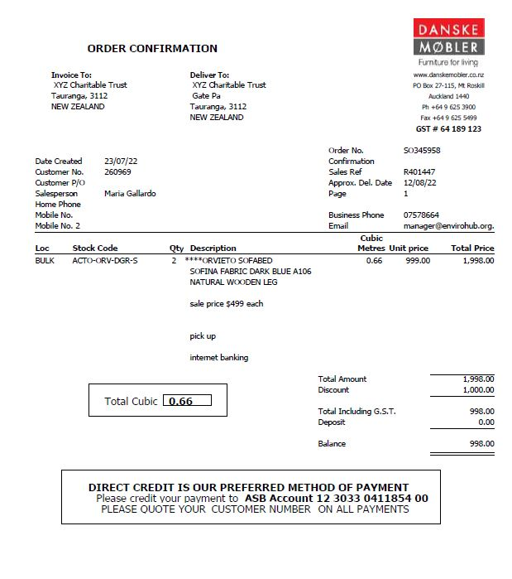
ORDER CONFIRMATION
GST number is included
Invoiced to the organisation
Notes:
Performance Report
Submitted in format required by Charities services, completing all sections
Signed off by organisation
Audit Report attached if your organisation is required to be audited
Don’t submit any other documents i.e. minutes
Rules
Make sure any rule changes have been signed off according to the rules of your organisation and then registered i.e If Incorporated Society and registered Charity. File changes first with Incorporated Societies through Companies Office. Once rule change has been approved file updated and approved rules with Charities.
Support
Case Studies using Client Profiles or similar. Check with client and make sure information does not lead to person being able to be identified
Letters of support for your service, a particular programme or project. i.e Letters of Support for a building project could be from individuals or other organisations who would use the new / renovated building
Template Documents
Client Profile template for Case Study
Standard Details template
About Us Summary

Slide 12
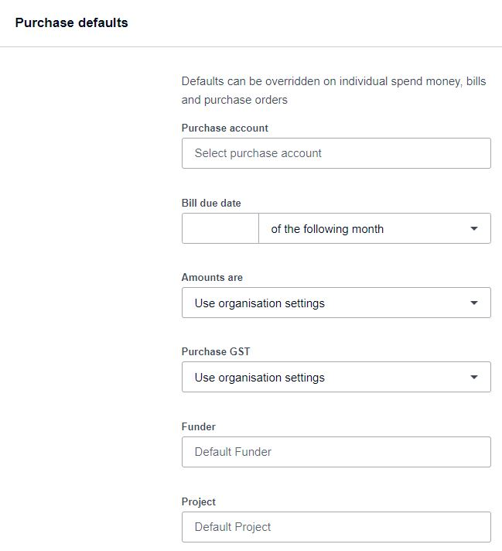
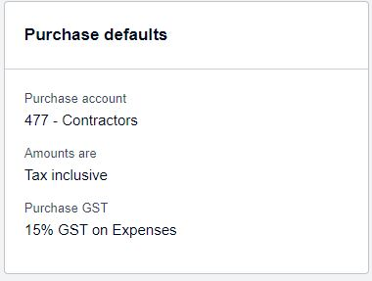
XERO TIME SAVING TIPS
Xero Dashboard – Contacts / Finance details
Then select “edit” followed by “Purchase defaults”
Customise financial details for this contact for consistency and time saving
You can also set up defaults for Tracking Categories you have set up for consistency and time saving
Notes:
Performance Report
Submitted in format required by Charities services, completing all sections
Signed off by organisation
Audit Report attached if your organisation is required to be audited
Don’t submit any other documents i.e. minutes
Rules
Make sure any rule changes have been signed off according to the rules of your organisation and then registered i.e If Incorporated Society and registered Charity. File changes first with Incorporated Societies through Companies Office. Once rule change has been approved file updated and approved rules with Charities.
Support
Case Studies using Client Profiles or similar. Check with client and make sure information does not lead to person being able to be identified
Letters of support for your service, a particular programme or project. i.e Letters of Support for a building project could be from individuals or other organisations who would use the new / renovated building
Template Documents
Client Profile template for Case Study
Standard Details template
About Us Summary

Slide 13
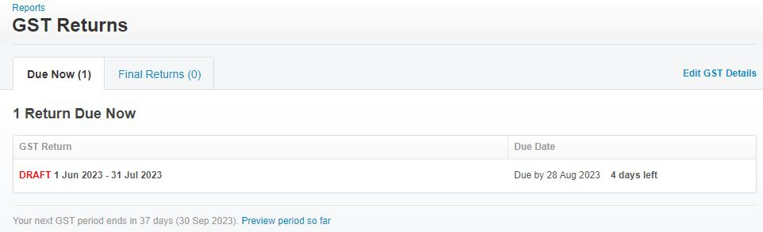
XERO FILING GST RETURNS
Xero Dashboard – Accounting / GST Return
Return due now - displays due date and how long left to file your return with the IRD
Check to see GST DUE or PAYABLE for the current period
Notes:
Use Demo Co for real example
Performance Report
Submitted in format required by Charities services, completing all sections
Signed off by organisation
Audit Report attached if your organisation is required to be audited
Don’t submit any other documents i.e. minutes
Rules
Make sure any rule changes have been signed off according to the rules of your organisation and then registered i.e If Incorporated Society and registered Charity. File changes first with Incorporated Societies through Companies Office. Once rule change has been approved file updated and approved rules with Charities.
Support
Case Studies using Client Profiles or similar. Check with client and make sure information does not lead to person being able to be identified
Letters of support for your service, a particular programme or project. i.e Letters of Support for a building project could be from individuals or other organisations who would use the new / renovated building
Template Documents
Client Profile template for Case Study
Standard Details template
About Us Summary

Slide 14
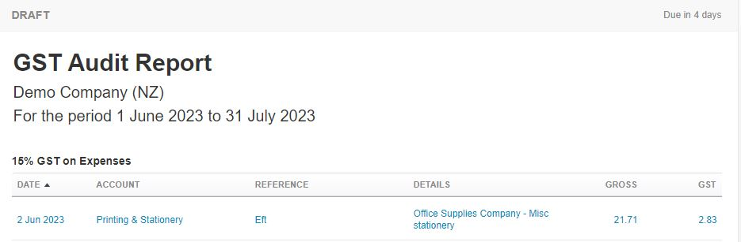
XERO GST RETURN CHECKLIST
Check transactions in “GST Audit Report” to ensure GST has been allocated correctly
Click on the blue text to go to the individual transaction to check details and update GST allocation if needed
2. Once you are happy that GST has been allocated correctly for all transactions in the period the return is being filed for:
“Export” a copy of the GST return to “PDF”
“Save” and select “Final”
3. Option at the top of your screen to file with IRD, click and enter your organisations MyIR username and password
4. Select “Publish” to complete the filing of your GST Return
Notes:
Performance Report
Submitted in format required by Charities services, completing all sections
Signed off by organisation
Audit Report attached if your organisation is required to be audited
Don’t submit any other documents i.e. minutes
Rules
Make sure any rule changes have been signed off according to the rules of your organisation and then registered i.e If Incorporated Society and registered Charity. File changes first with Incorporated Societies through Companies Office. Once rule change has been approved file updated and approved rules with Charities.
Support
Case Studies using Client Profiles or similar. Check with client and make sure information does not lead to person being able to be identified
Letters of support for your service, a particular programme or project. i.e Letters of Support for a building project could be from individuals or other organisations who would use the new / renovated building
Template Documents
Client Profile template for Case Study
Standard Details template
About Us Summary

Slide 15
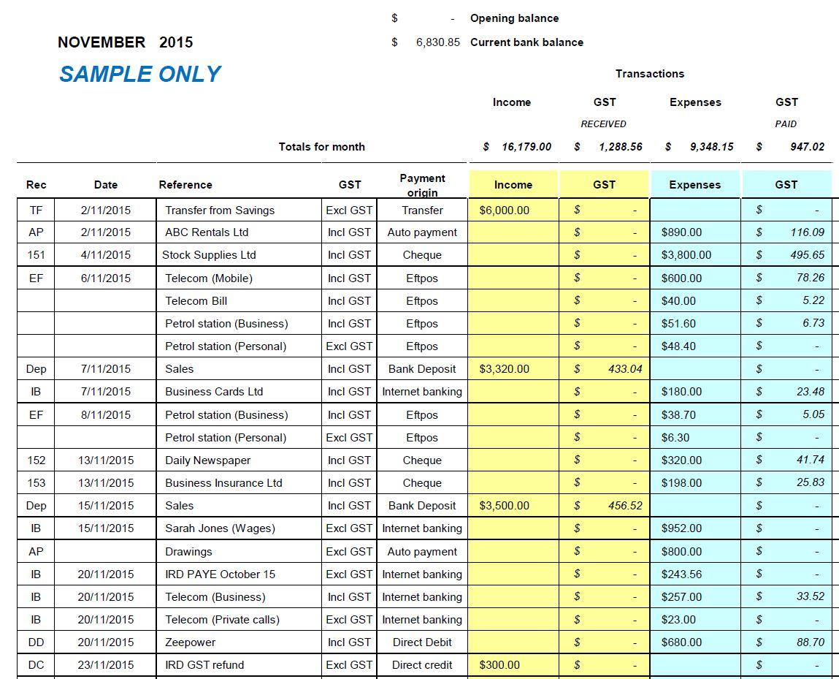
EXCEL CASHBOOK & GST
If you don’t have accounting software you may prefer to keep a manual record of your income and expenses and also GST
SAMPLE
Excel Template from IRD website downloaded & will be emailed to attendees
Notes:
Performance Report
Submitted in format required by Charities services, completing all sections
Signed off by organisation
Audit Report attached if your organisation is required to be audited
Don’t submit any other documents i.e. minutes
Rules
Make sure any rule changes have been signed off according to the rules of your organisation and then registered i.e If Incorporated Society and registered Charity. File changes first with Incorporated Societies through Companies Office. Once rule change has been approved file updated and approved rules with Charities.
Support
Case Studies using Client Profiles or similar. Check with client and make sure information does not lead to person being able to be identified
Letters of support for your service, a particular programme or project. i.e Letters of Support for a building project could be from individuals or other organisations who would use the new / renovated building
Template Documents
Client Profile template for Case Study
Standard Details template
About Us Summary

Slide 16
PAYROLL
Own Payroll System / Records
IRD filing required depending on system used
Use accounting packages like Xero to help manage payroll
Manual calculations may be required for Holiday Pay i.e. Gross Earnings X holiday pay %
PAYE Intermediary
A PAYE Intermediary engages with the IRD on your behalf and assists your organisation to fulfil your legal obligations as an employer.
These services generally include:
Filing your employee information forms.
Paying IRD the deductions made from your employees’ pay each month.
Resolving queries with IRD
Software that use employee start date and payroll records to calculate an employee leave availability
PAYE Intermediaries can be payroll software providers, accountants or tax agents.
Charities - Some Intermediaries charge a standard rate for their services and others offer discounts or free services

Slide 17
PAYROLL
What | Own Systems / Records | PAYE Intermediary
Payroll filing | You must file an employment information form every time you pay your employees. This is based on the date you pay employees (pay day) and may be weekly, fortnightly, monthly or more often if you have multiple paydays. Electronic filing must be within 2 working days of each day pay, paper filing within 10 working days. | File your employee information forms Pay IRD the deductions made from your employees’ pay each month Filings completed by due date
Managing leave | Manual calculations may be required for Holiday Pay i.e. Gross Earnings X holiday pay % | Accurate record of all types of leave. Also helps to manage Annual Leave liability
Record keeping | May mean record keeping for various sources | History, audit trail of payroll
Employee Interaction | Varies depending on how manual your payroll system is and which accounting software is used | Payslips can be emailed, most have apps

Slide 18
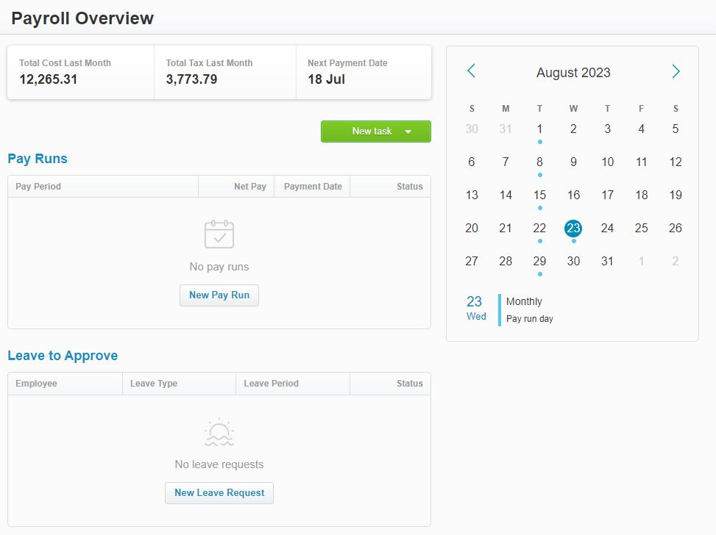
Xero PAYROLL
ADDITIONAL COST FOR PAYROLL
Starter, Standard & Premium Plans:
Additional $10 + GST per month
Xero Me
Gives access to your employees to view payslips, request leave, or submit timesheets with Xero’s payroll system for your small business.
ADDITIONAL COST FOR CLAIM EXPENSES
Standard & Premium Plans:
Additional from $5 + GST per user
Note: Claim Expenses not available for Starter Plan.
https://www.xero.com/nz/accounting-software/payroll/
Notes:
https://www.xero.com/nz/accounting-software/payroll/ - play video
Xero Me for payroll - https://www.xero.com/nz/xero-me/ - play video
Go to Demo Co Payroll

Slide 19
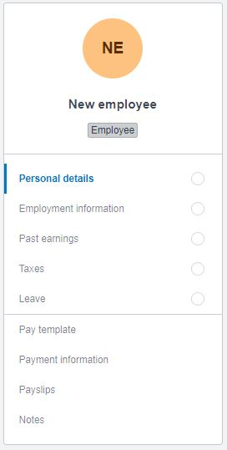
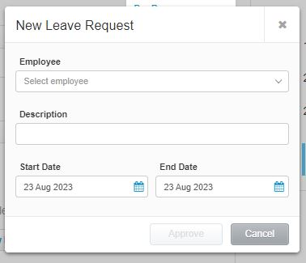
Xero PAYROLL

Slide 20
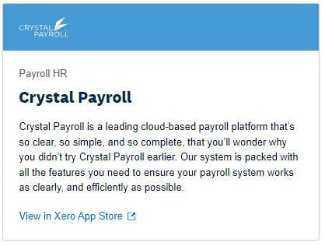
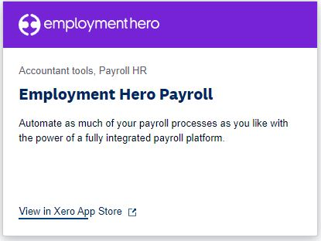
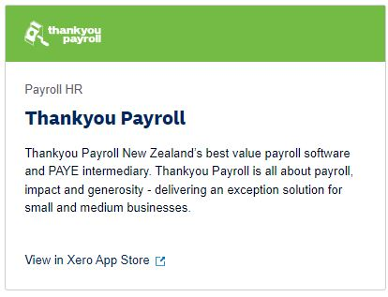
PAYE INTERMEDIARIES
There are many PAYE Intermediaries to choose from, here is a selection that integrate with Xero
From $19.90 per month for up to 5 employees for Self Service package
10% off payroll subscription and 50% off data transfer costs, and free training sessions for Charities
https://crystalpayroll.com/pricing/
From $2 per employee / month
$4 per employee / month including reporting, accounting integration
https://employmenthero.com/nz/pricing/?pricing-tab=payroll
Cost varies depending on how many people you have to pay and how often you pay your employees
Free payroll offered for Charities
https://www.thankyoupayroll.co.nz/payroll-for-charities/

Slide 21
THANKYOU PAYROLL
Things I like about Thankyou Payroll:
No fees for Charities
Xero integration
Time-saving default payruns (it takes 5 - 10 minutes to process payroll)
Same day phone and email support from NZ based payroll experts plus good online help and resources
Compliance with IRD
Thankyou Payroll invests a portion of its profits into Thankyou Payroll Charitable Trust which distributes funds to organisations across NZ
Allows for Payroll Giving
APP for staff to use to access current leave availability etc

Slide 22
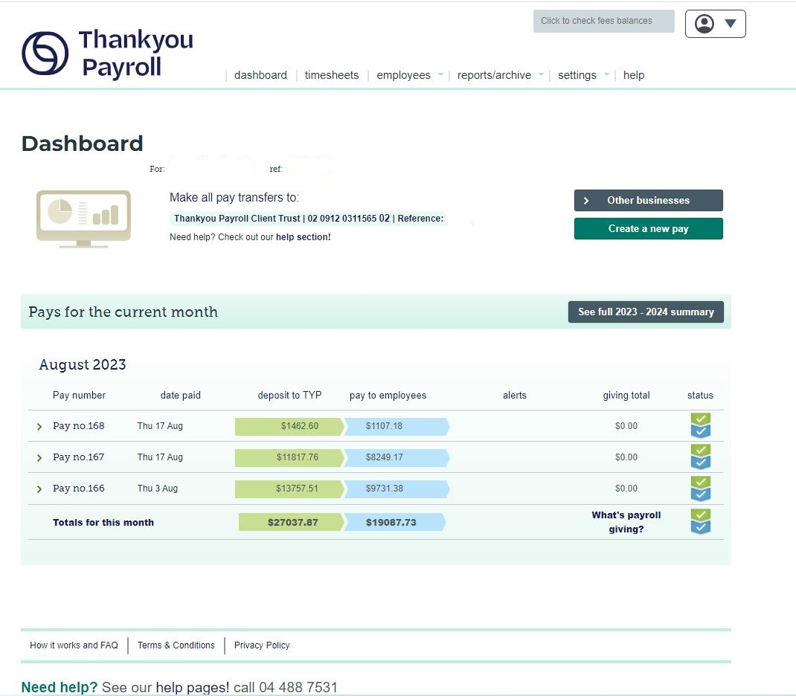

Slide 23
USEFUL RESOURCES
Payroll Software vs PAYE Intermediaries (video)
https://www.youtube.com/watch?v=iNeKzvgsrKo
Thankyou Payroll
https://www.thankyoupayroll.co.nz/payroll-for-charities/
Inland Revenue
https://www.ird.govt.nz/gst
https://www.ird.govt.nz/employing-staff
Xero
Payroll
https://www.xero.com/nz/accounting-software/payroll/

Slide 24
FINAL UNDERSTANDING FINANCES WORKSHOP
Annual Financial Statements
22 September, 10am - 12pm

